Slide 1


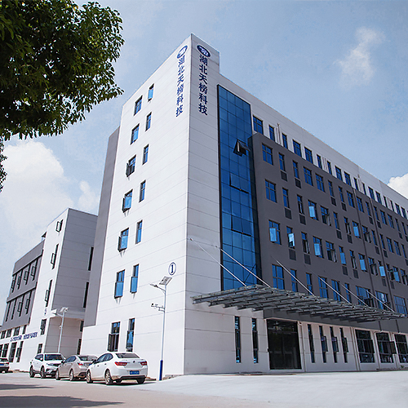

HUBEI TIANBANG
Automotive Electronic Technology Co.,ltd
湖北天榜汽车电子科技有限公司
0728-5353068
www.tb-autoparts.cn

Slide 2

1
TIANABNG at a glance
2
Our Products
CONTENTS
3
Research&Innovation
4
Why Choose US

Slide 3

1
Part
Company Profile

Slide 4
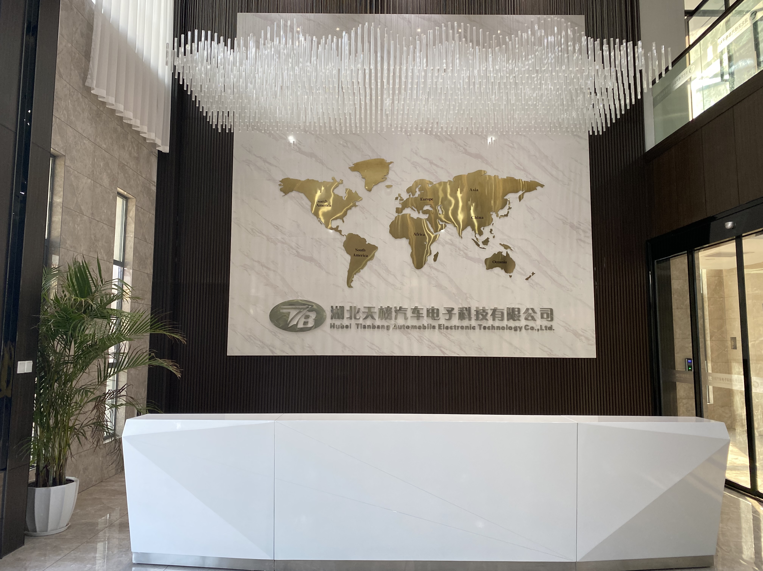
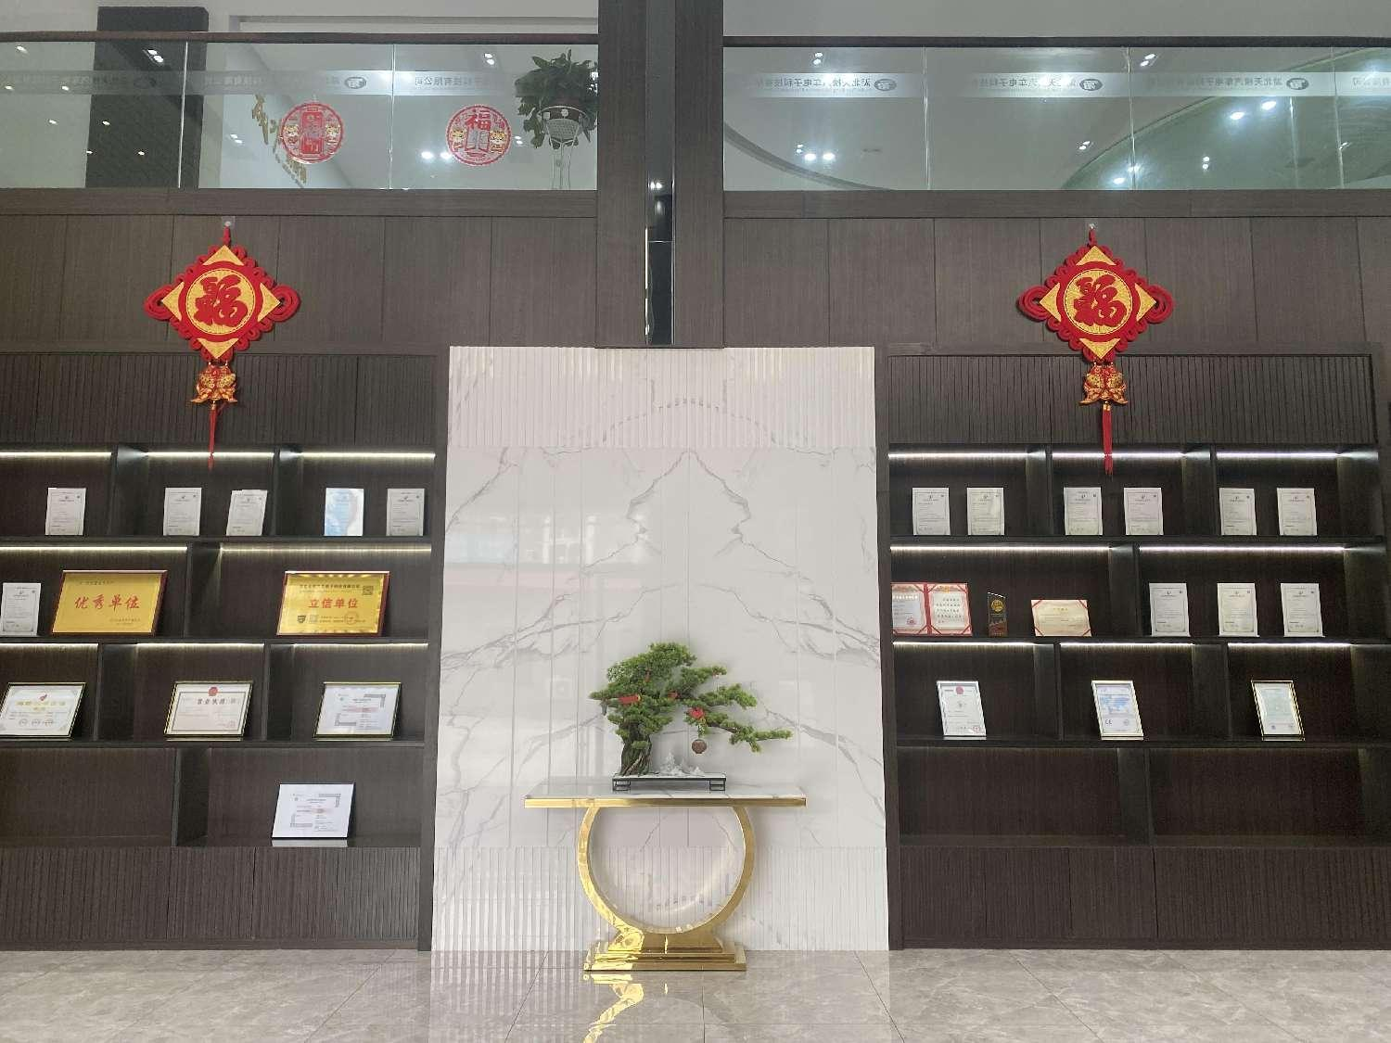
About us
Hubei TIANBANG , was founded in 2006 , is a IATF16949 certified leading manufacturer of auto sensors for independent aftermarket . It is a national high-tech enterprise that integrates research and development, production, sales and service of exhaust and emission control system SENSORS . Applications available for motorcycles ,passenger cars and commercial vehicles .
The state-of-the-art manufacturing facility with stringent quality control to ensure our products a 100% OE-compliant quality and an exact fit . Our product range : Oxygen Sensors / EGT Sensors / NOx Sensor ...
Thanks to our dedication to quality and customer service, we have built
strong, collaborative partnerships with customers worldwide .
We adhere to the business principle of "OEM quality -Aftermarket price",，Always strive to provide high-quality products at competitive prices . TIANABNG invites you to be a part of this big family for profitable and reliable business partnership.

Slide 5
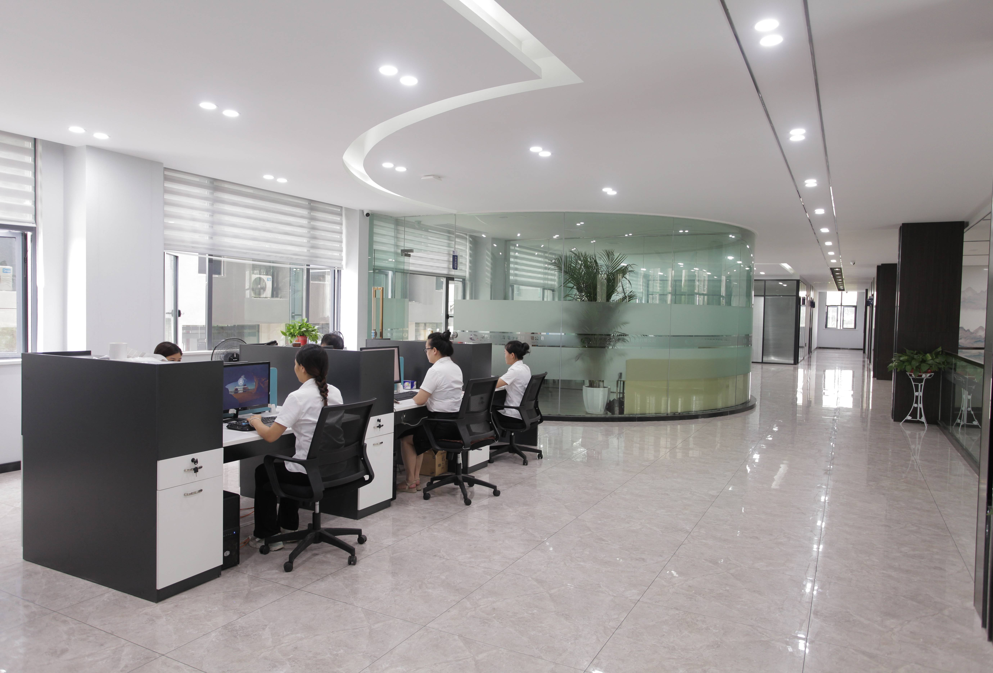
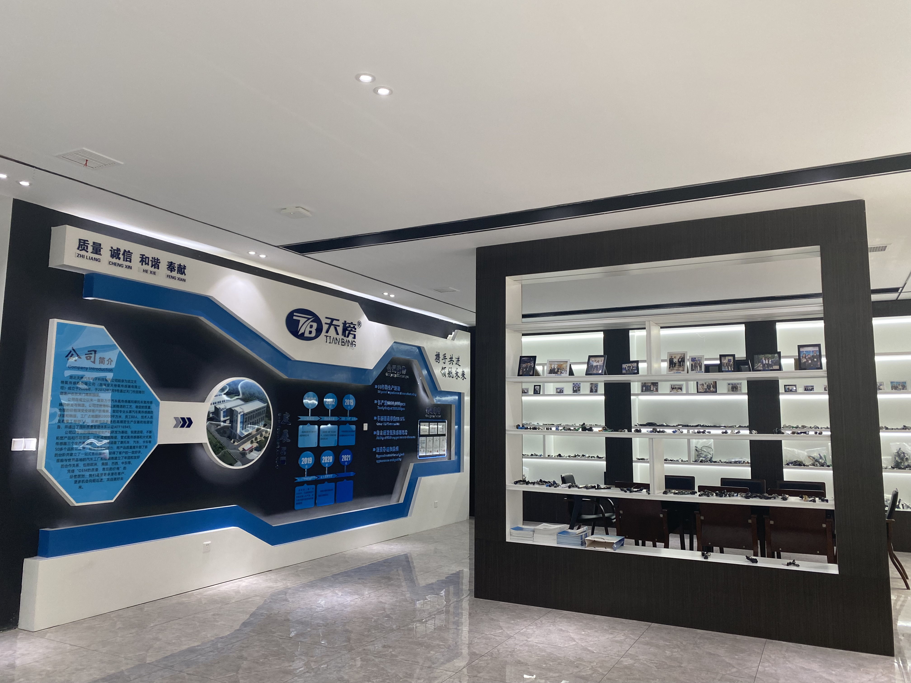
Company Information
Year of establishment：2006
Orgnazation：7 departments
Employees：100
Production base：2 (WuHan&TianMen)
Floor area：20,000㎡
Main market：Europe,North America
South America，the Middle East

Slide 6



Company Honors
High-tech Enterprise
Integrity unit
High-tech Enterprise certificate
Hubei Province “Lixin Unit”
Hubei AAA Quality Service Integrity Unit
Hubei AAA-level Credit Enterprise

Slide 7
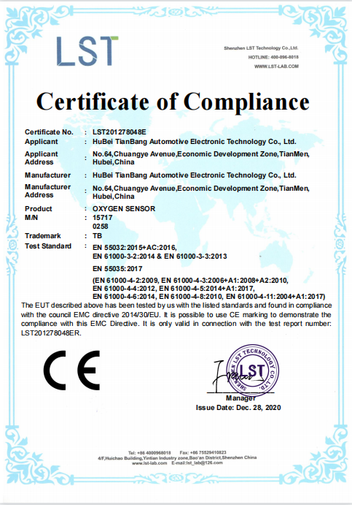
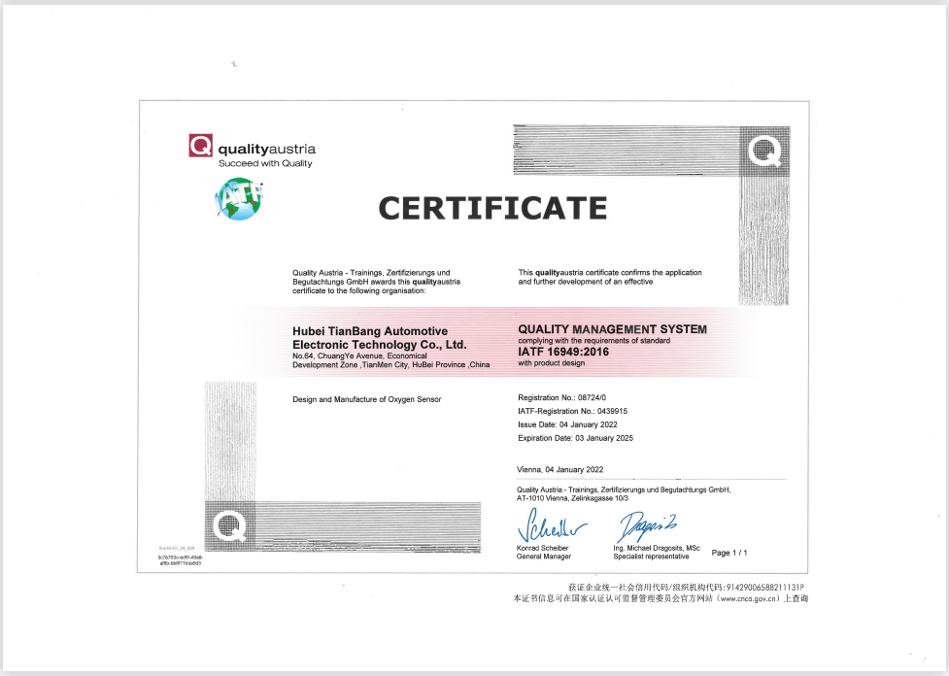
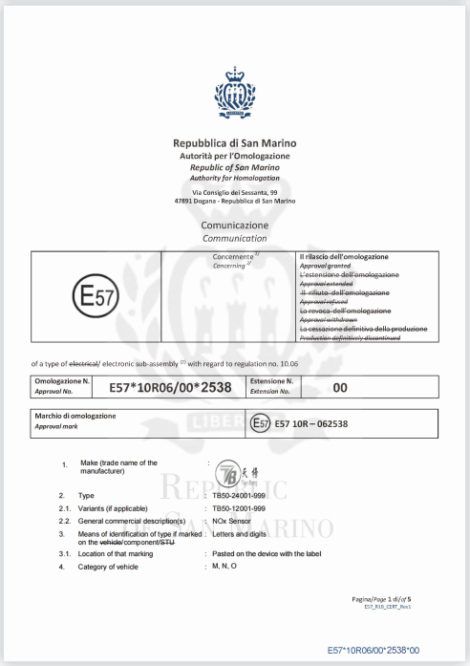
Product Certification
Our company has successfully passed the IATF 16949 surveillance audits,
products gain CE & E-mark certification
At present, has obtained 15 utility model patents

Slide 8

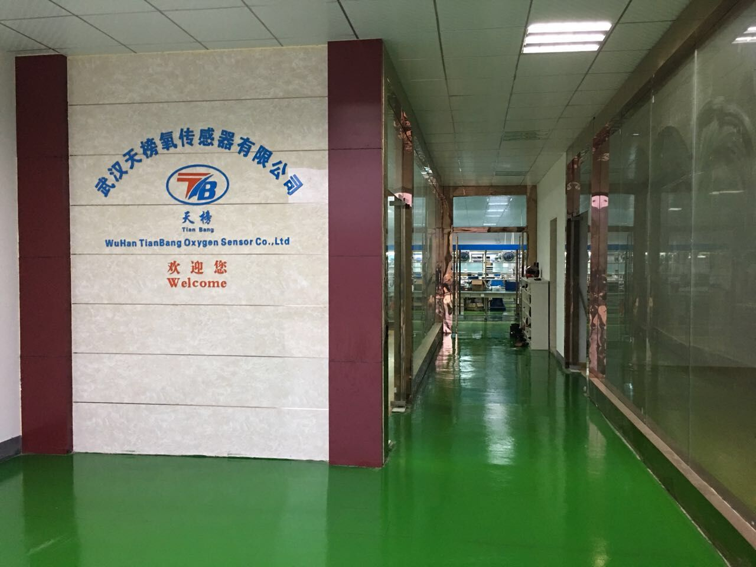
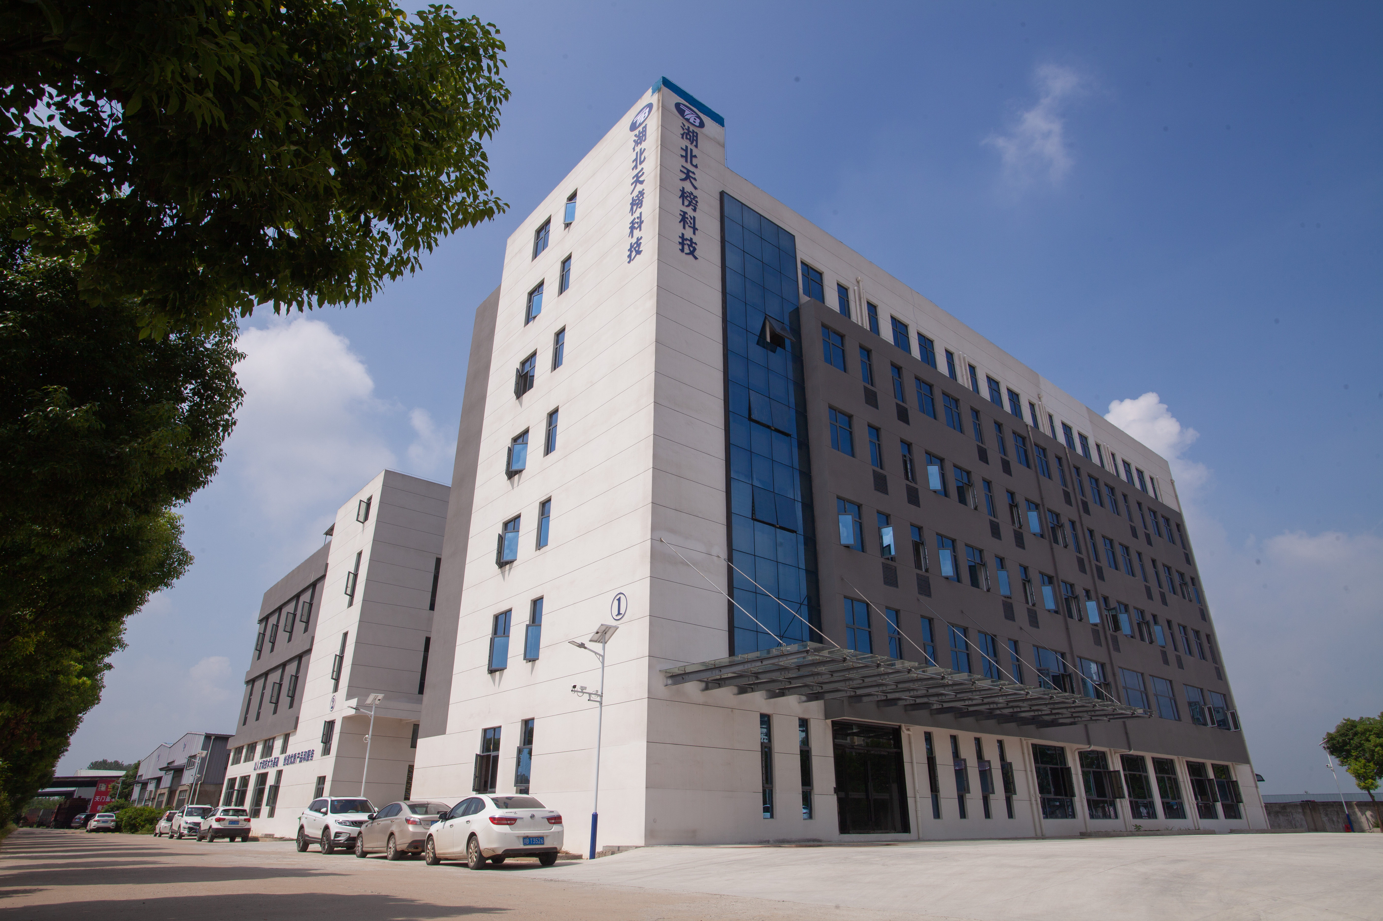
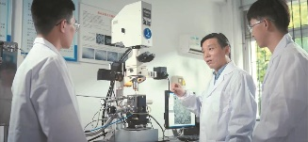


Company Milestones
2009
2016
2023
2006
2012
2019
started oxygen
sensors manufactur-
ing in Zhejiang
Province
Built Phase II Facility
starte the
production of
EGT sensor and
NOx sensor
Moved to Hubei
Province , and
built Facility Phase I
Started the R & D
and production of
ceramic chips
Cooperated with
Wuhan Science
& Technology
University to
develop tubular
oxygen sensor
chips,make up the domestic blank
Got export rights
and start the
cooperation with
well-known
American brands
obtained the
certification
IATF16949
Based on reliable
technical support
and perfect
service system,
we are constantly
seeking win-win
partners in the
global market.

Slide 9

Organization
GM
R&D
QC
Markting&Sales
HR
Financial
Production
Purchasing
Marketing
sales
Assistant Team
Workshop
Warehouse

Slide 10

Market Distribution
Major countries&regions
Asia
China（Mainland）、Japan、Korea
Italy、Germany、Spain、 Netherland、Poland
America、Cananda 、Mexico
Brazil、Argentina、Colombia
UAE、Turkey
Europe
North America
South America
the Middle East

Slide 11
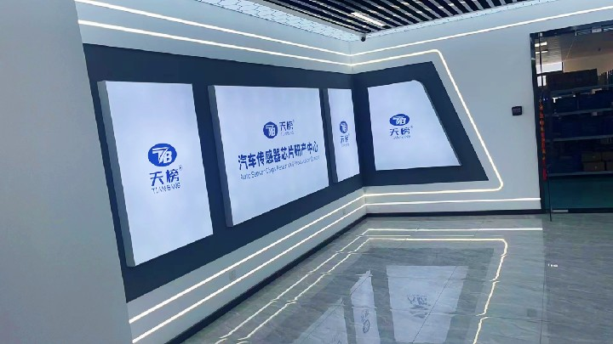
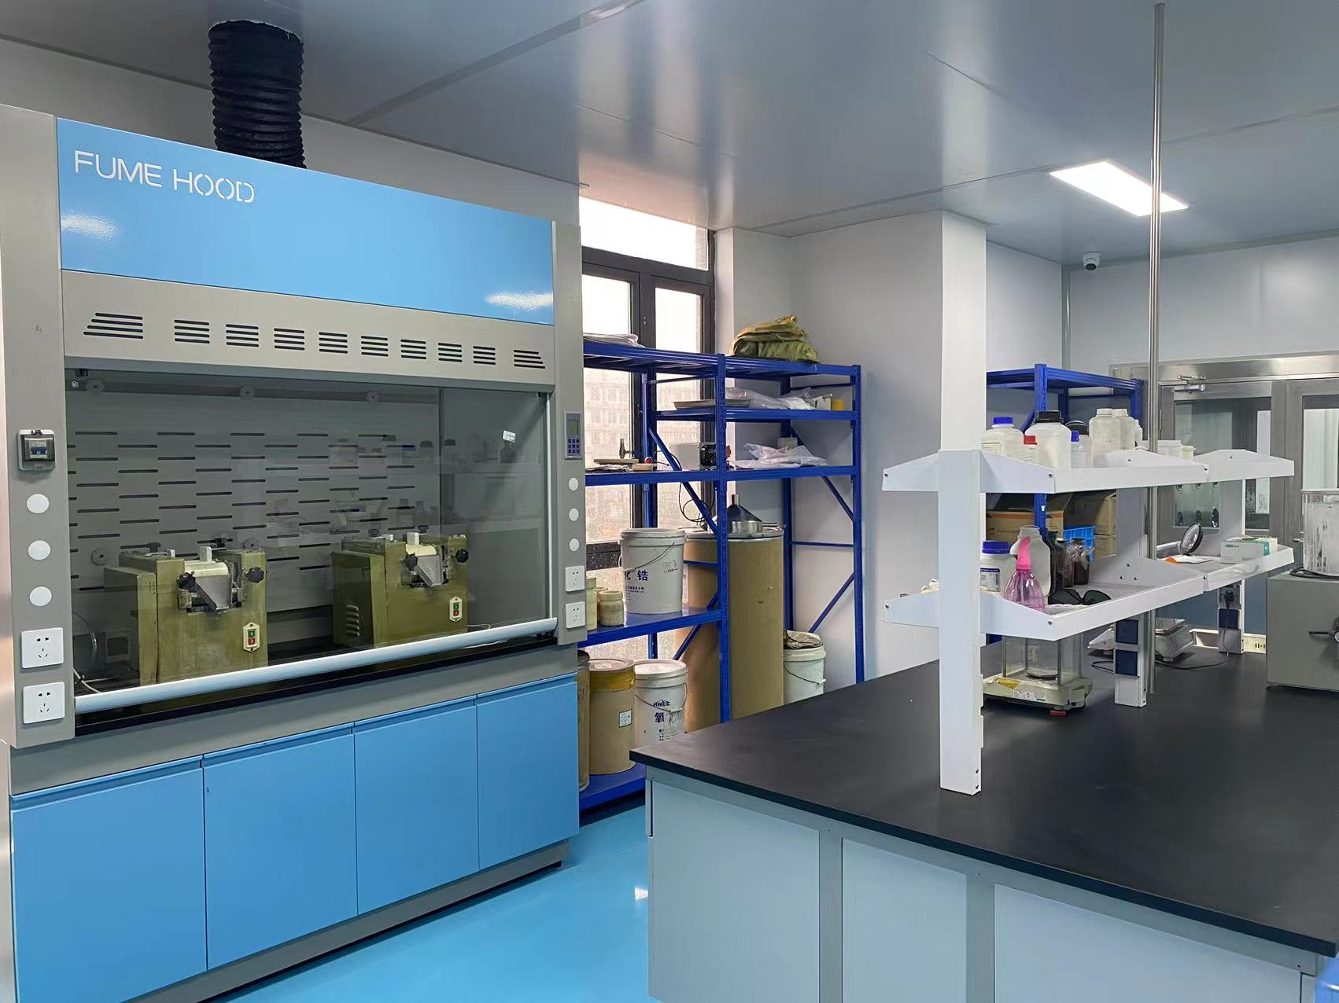
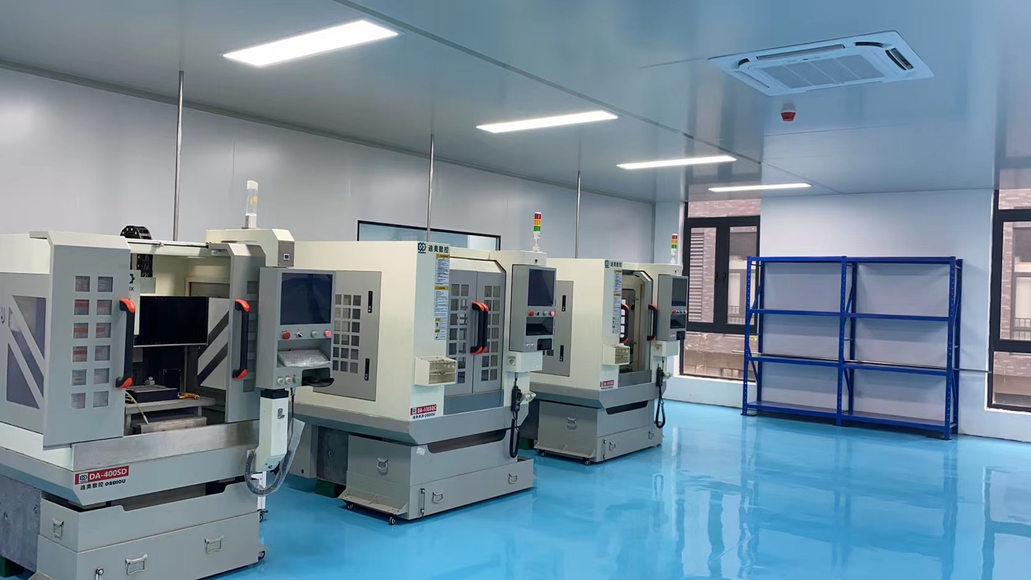
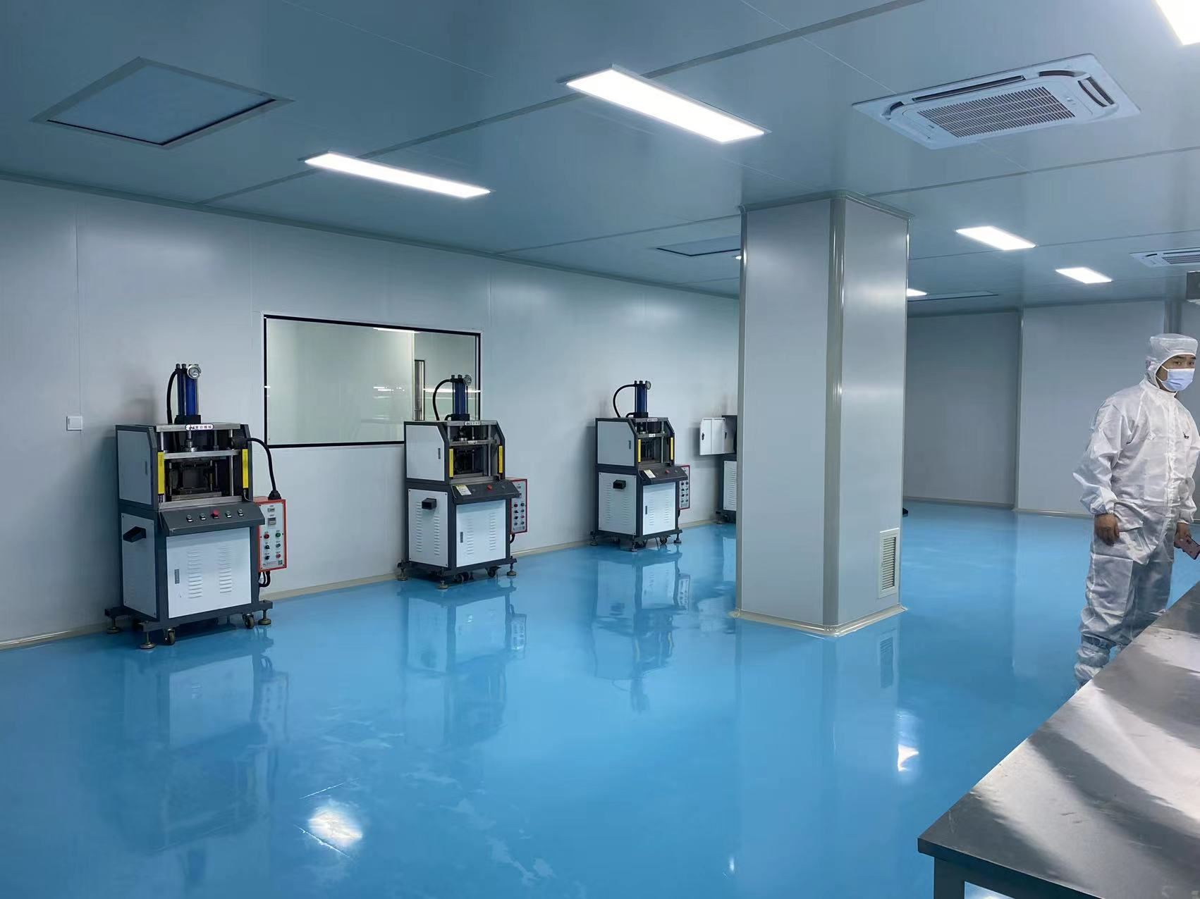
Workshop-Ceramic chips
2000㎡ dustless workshop
2 advanced intelligent automated production line
Yearly output 3000,000 pcs

Slide 12
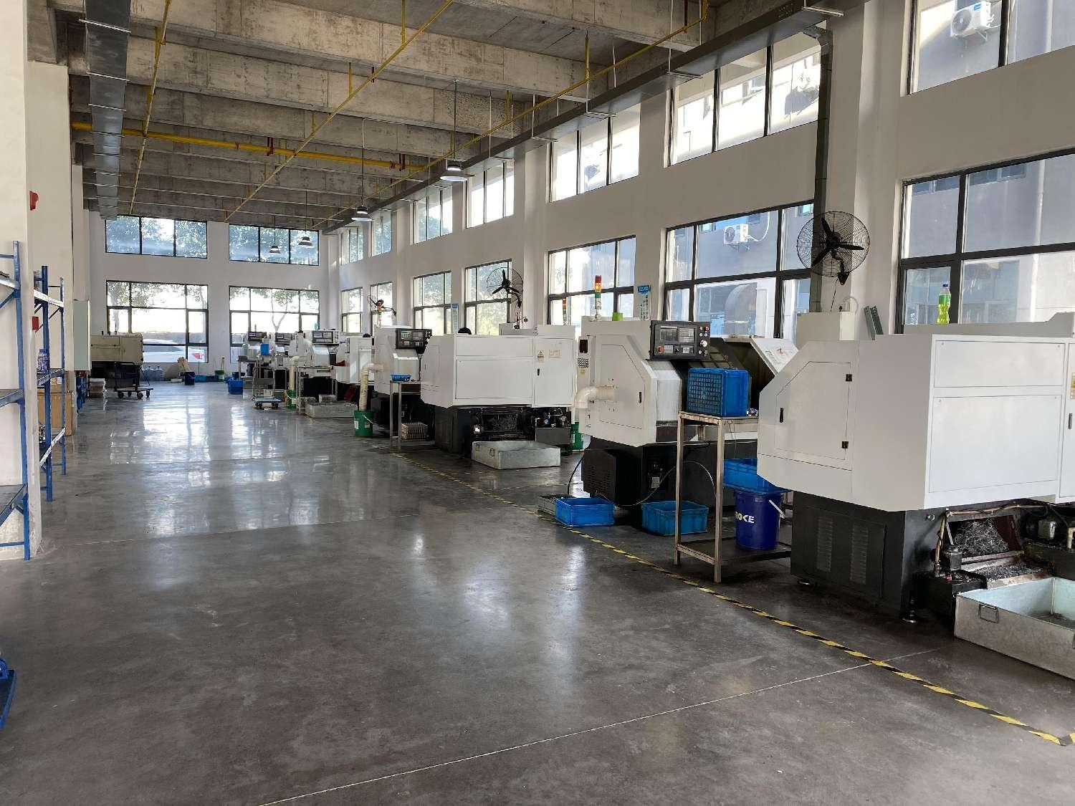
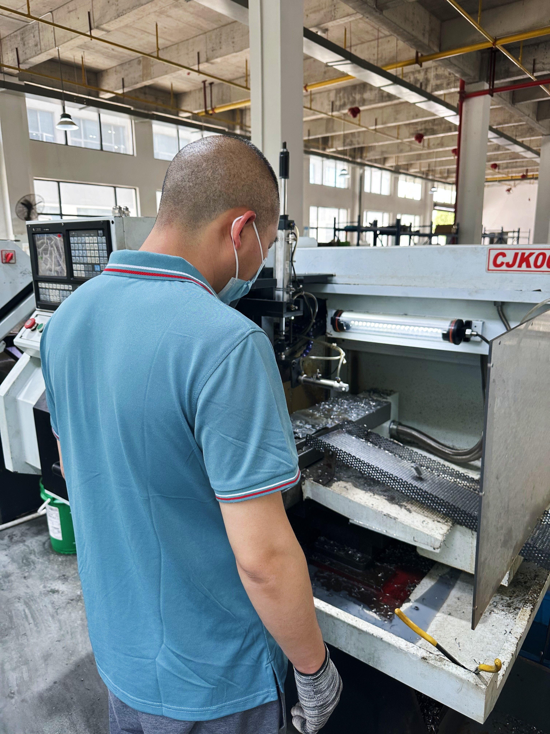
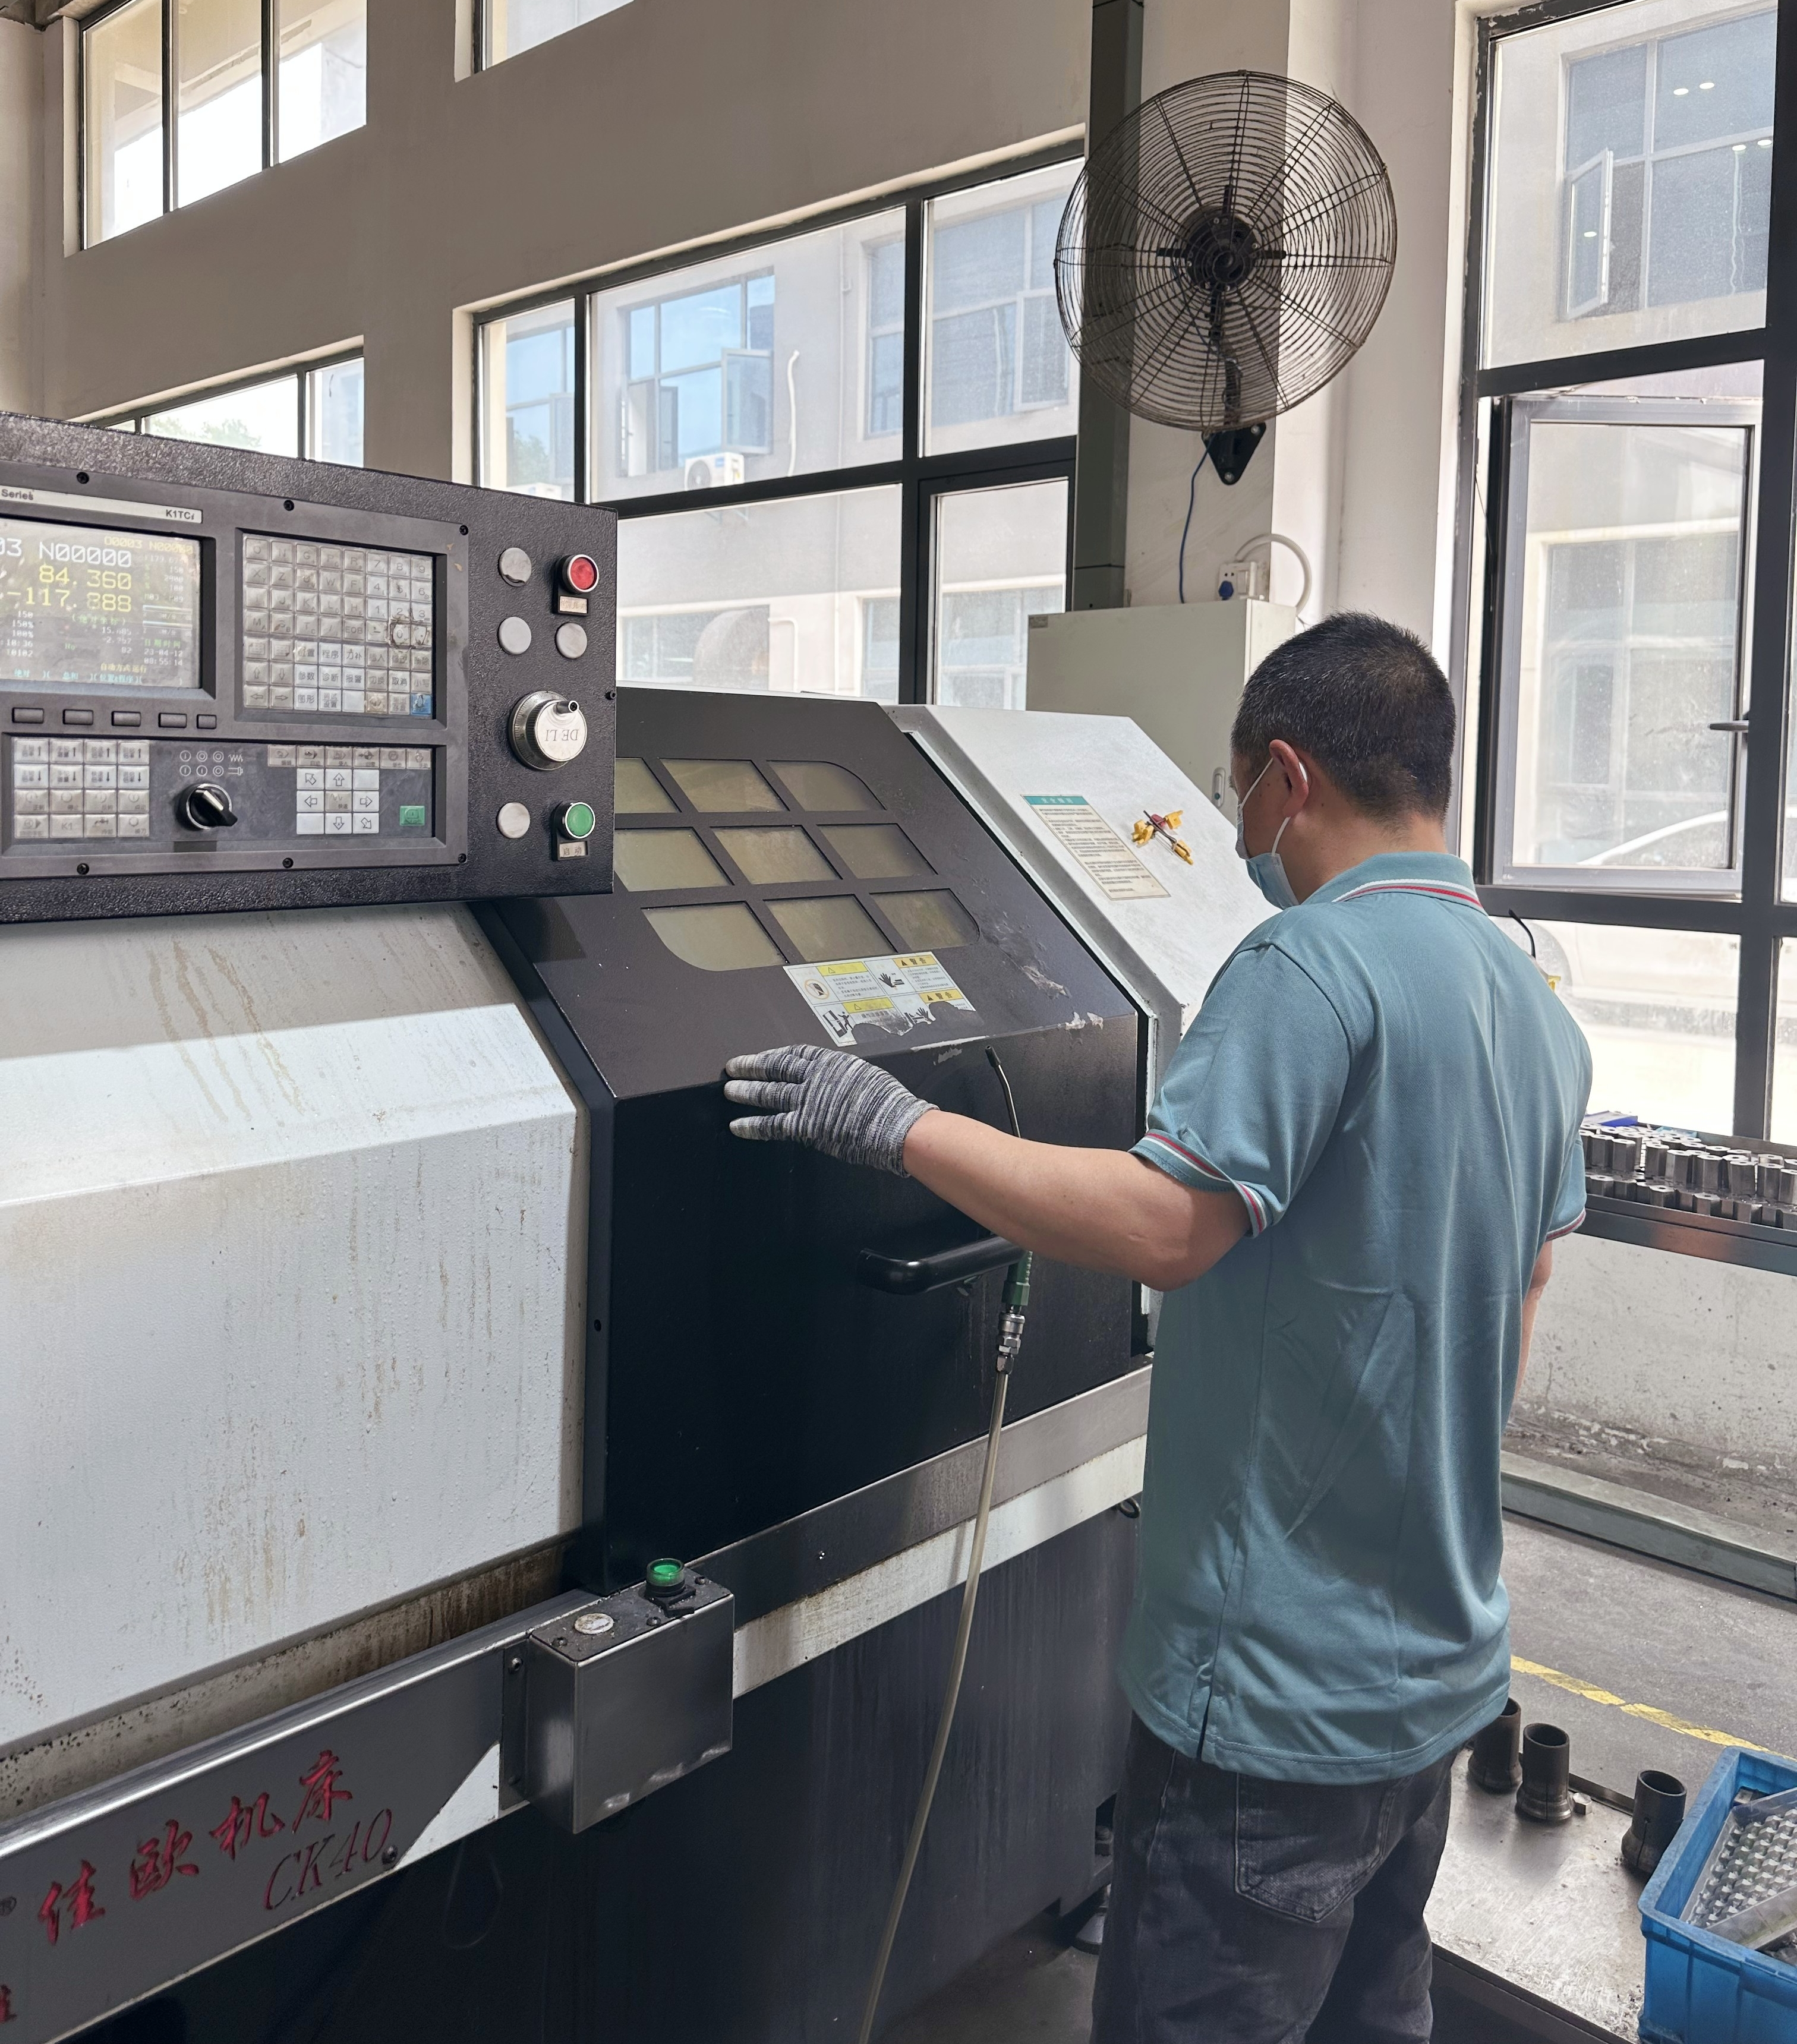
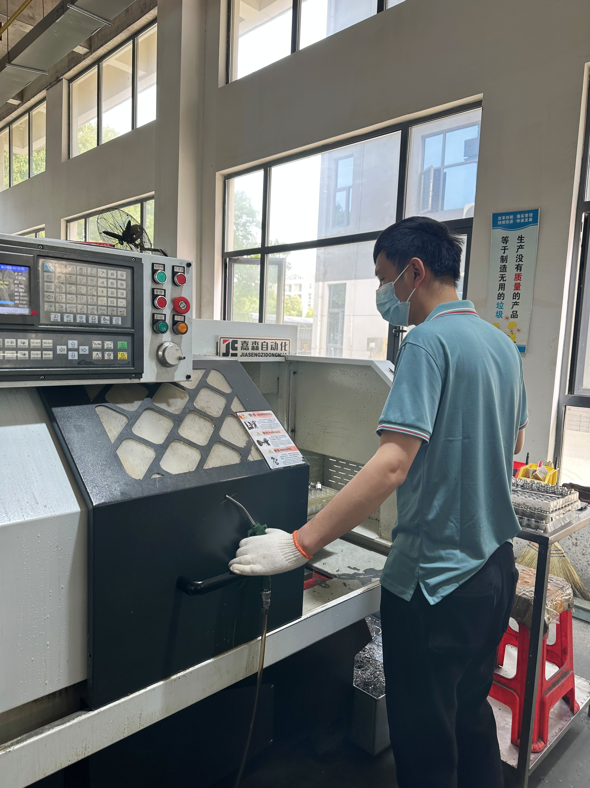
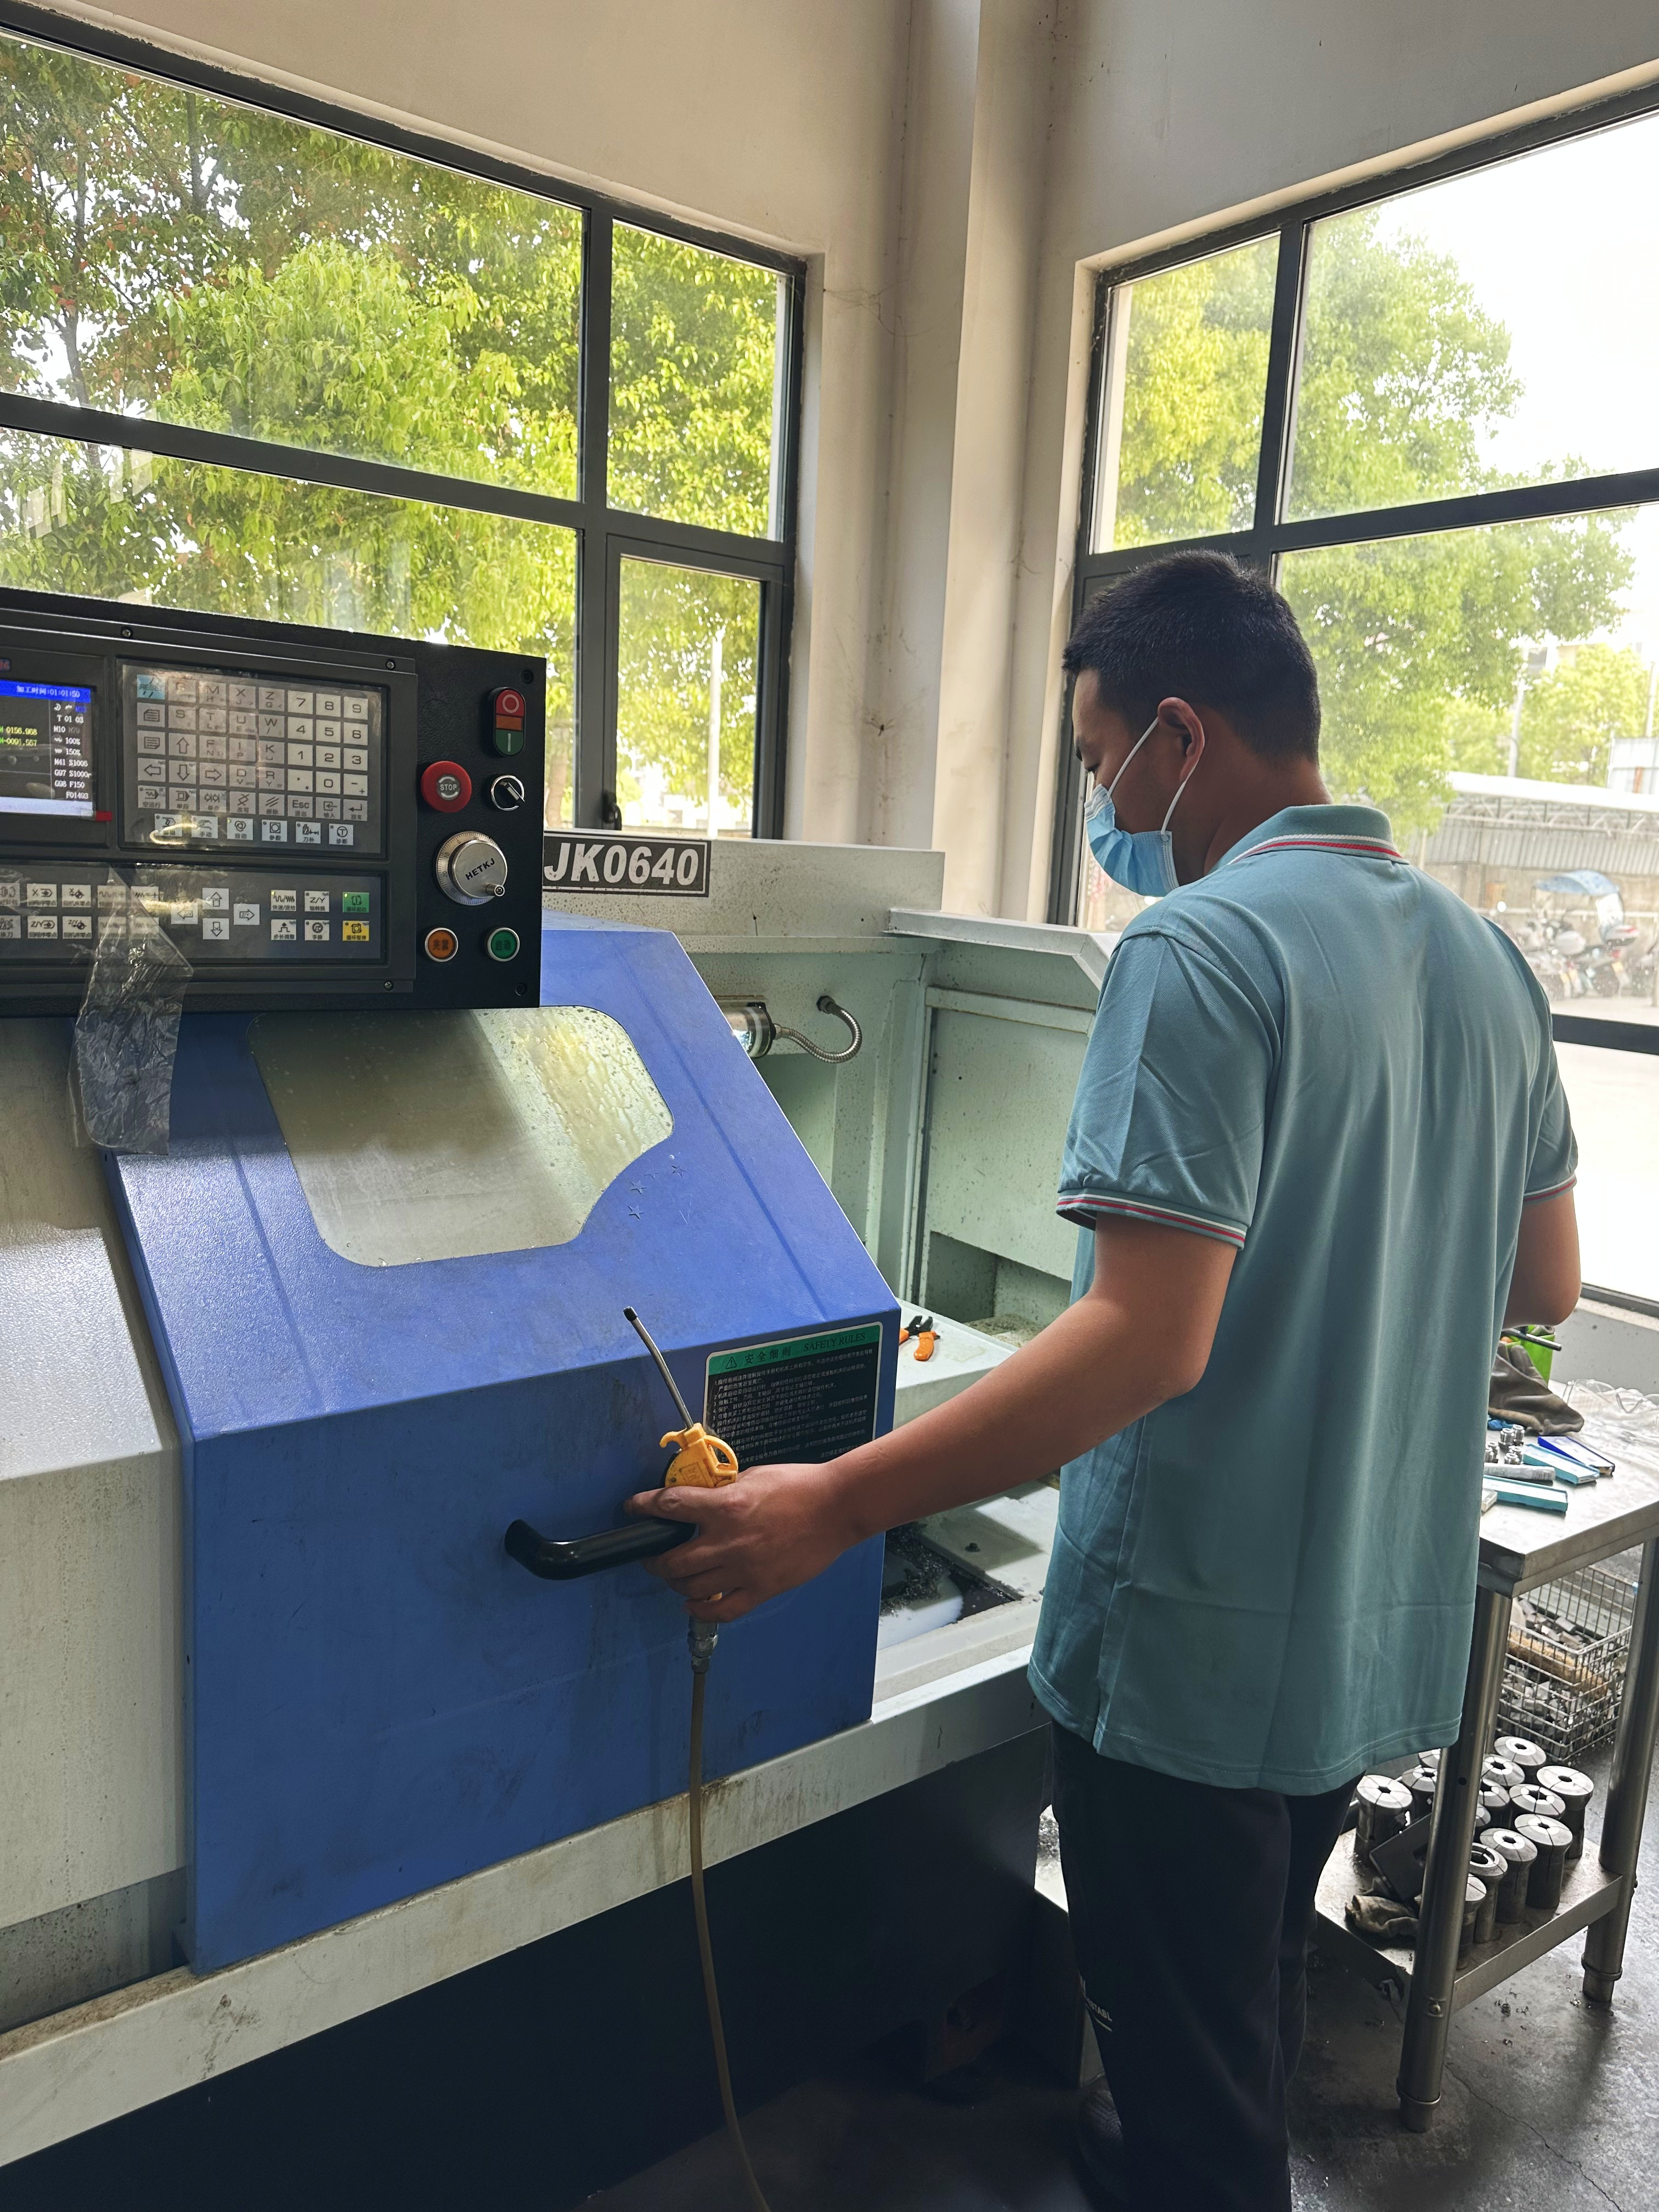
Workshop-Machining
Stable supply of core raw materials
Metal parts Hex base and nuts
Yearly output 1500,000 set

Slide 13
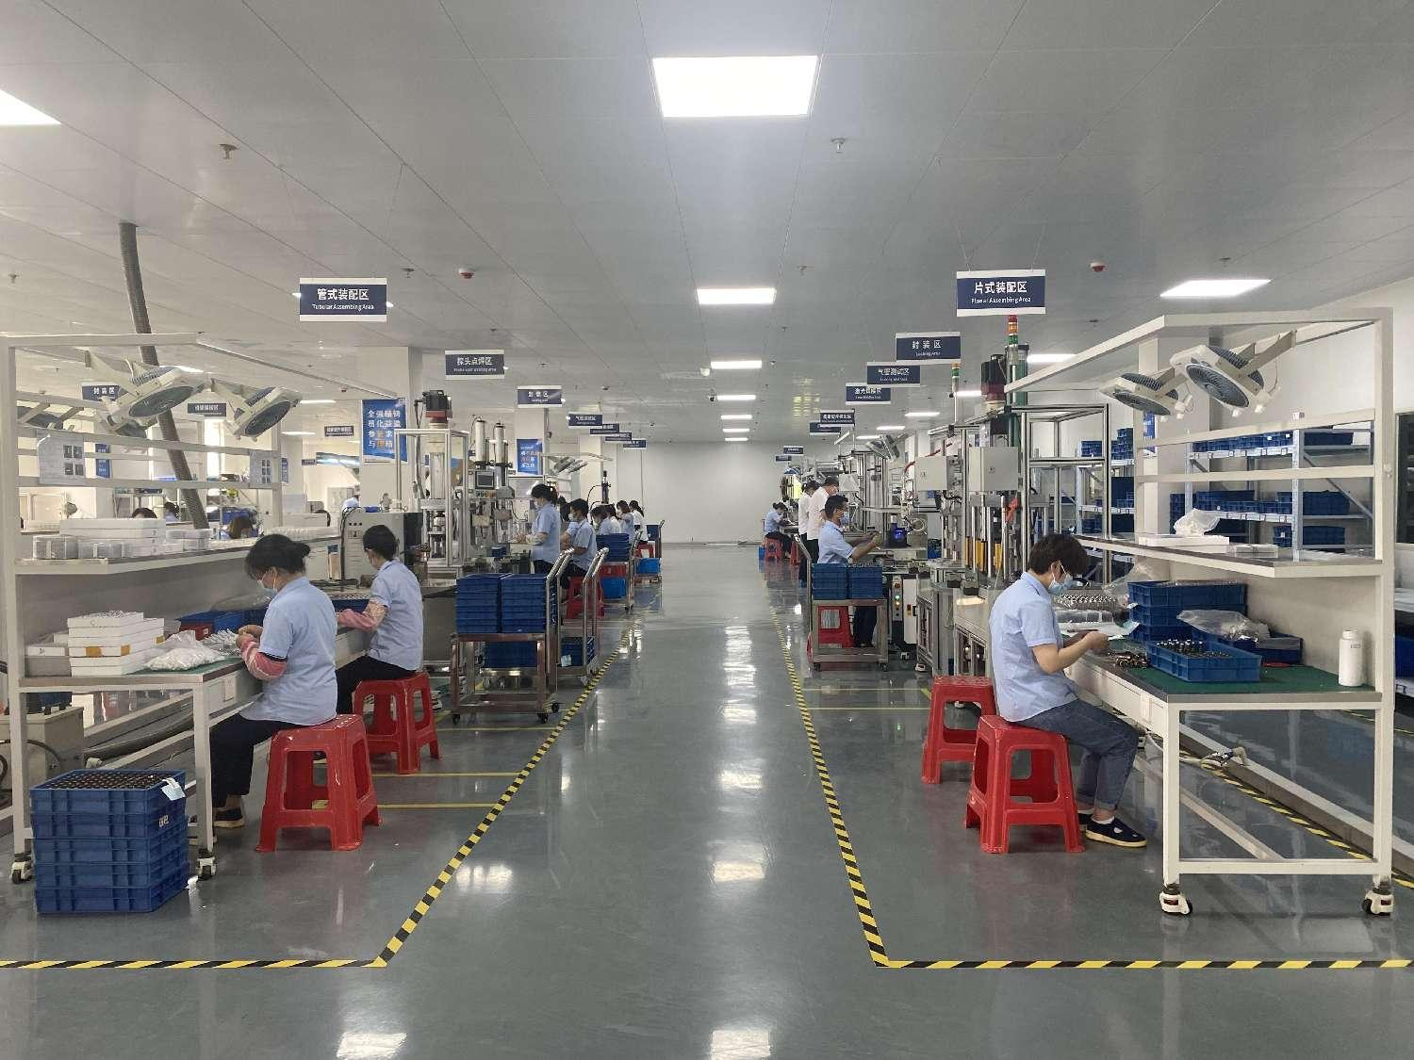
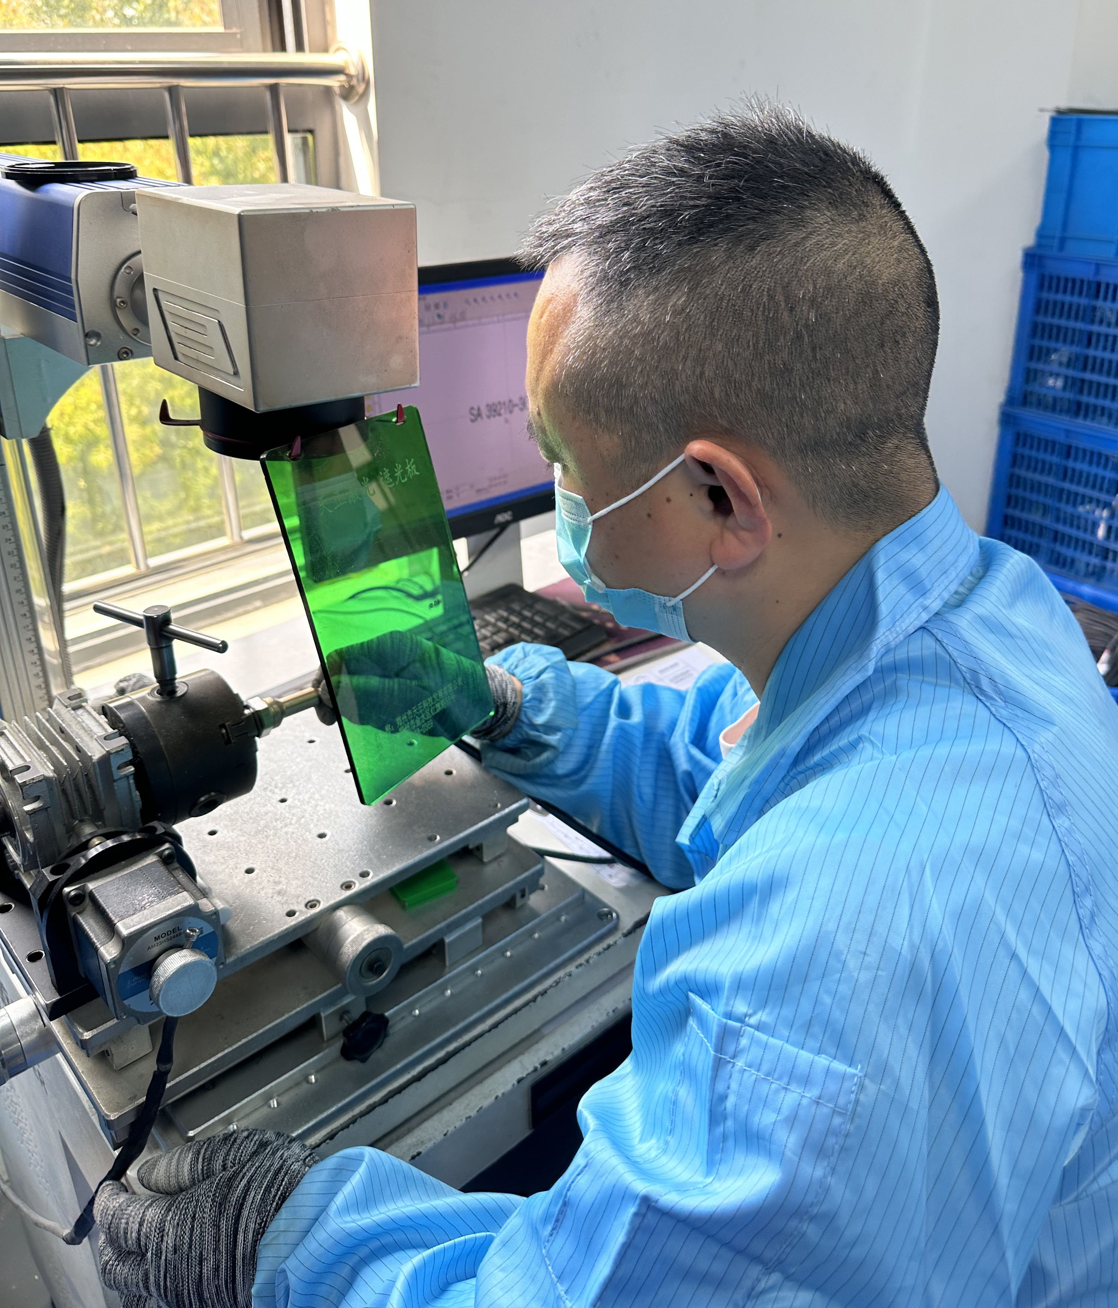
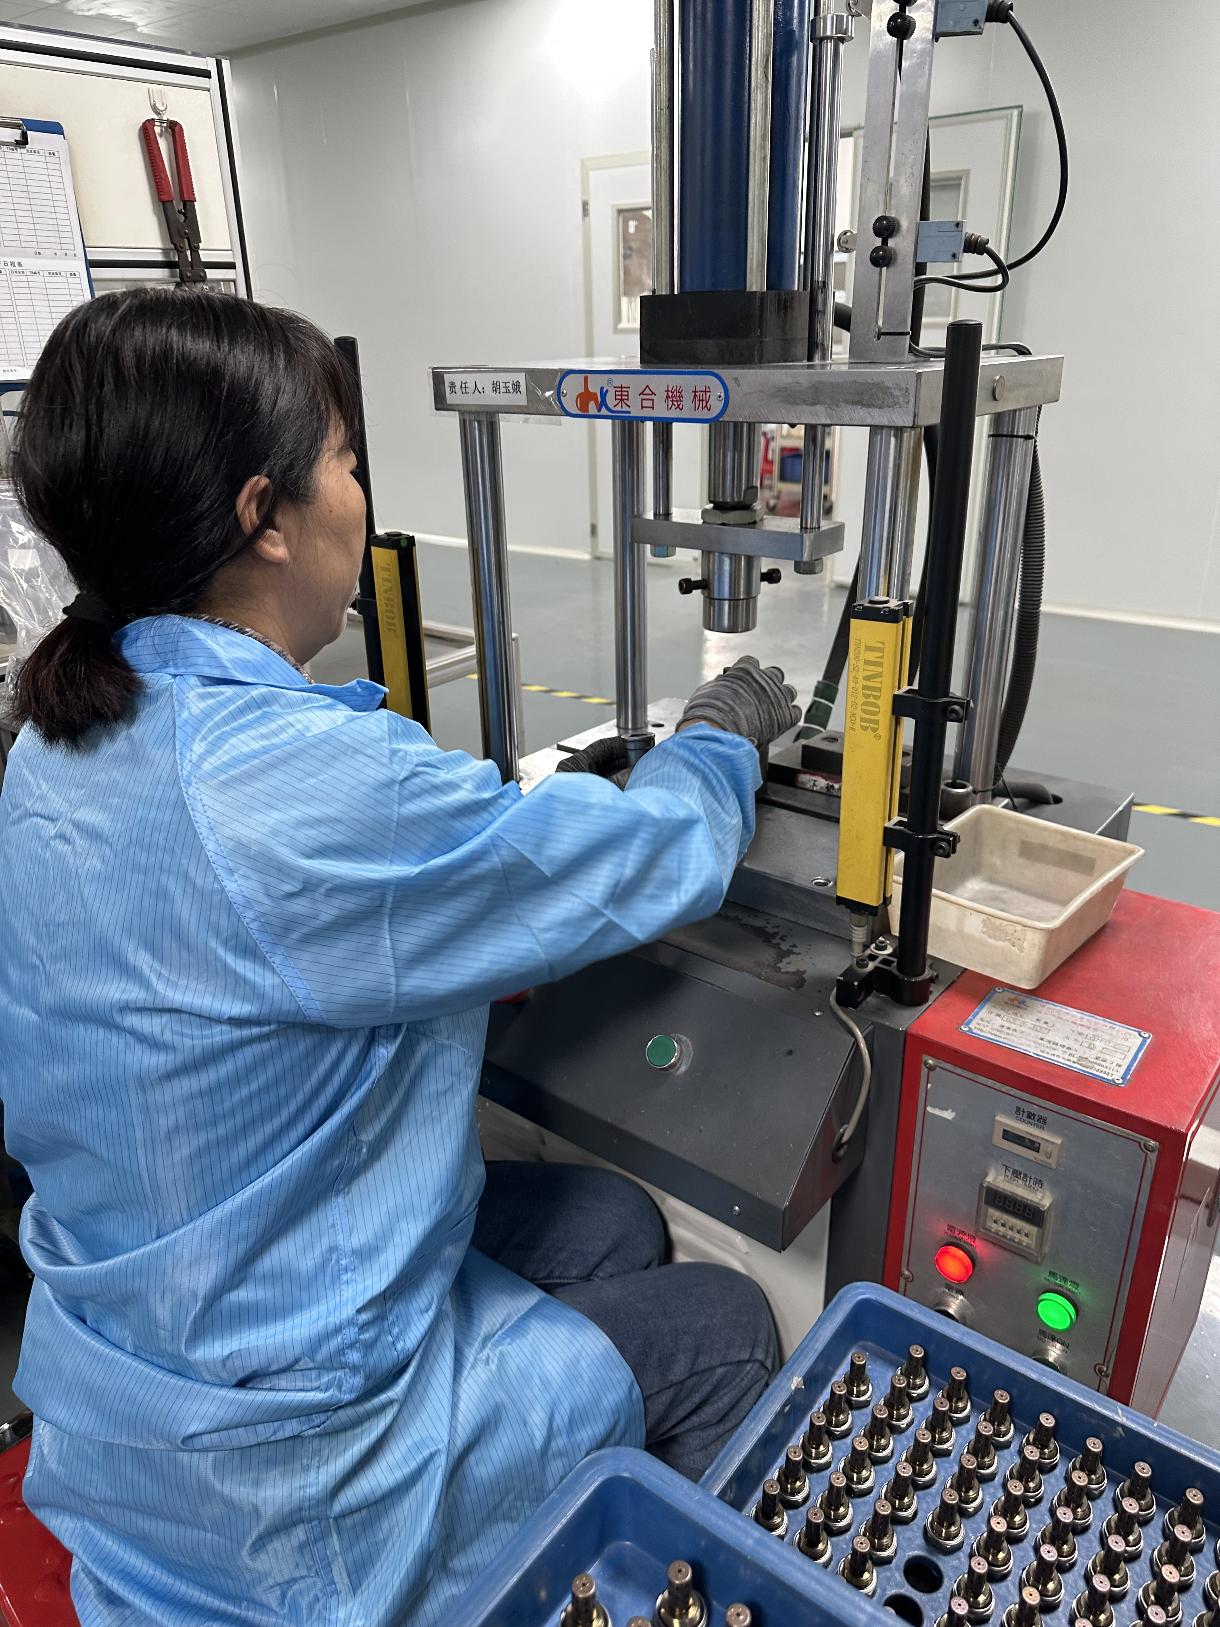
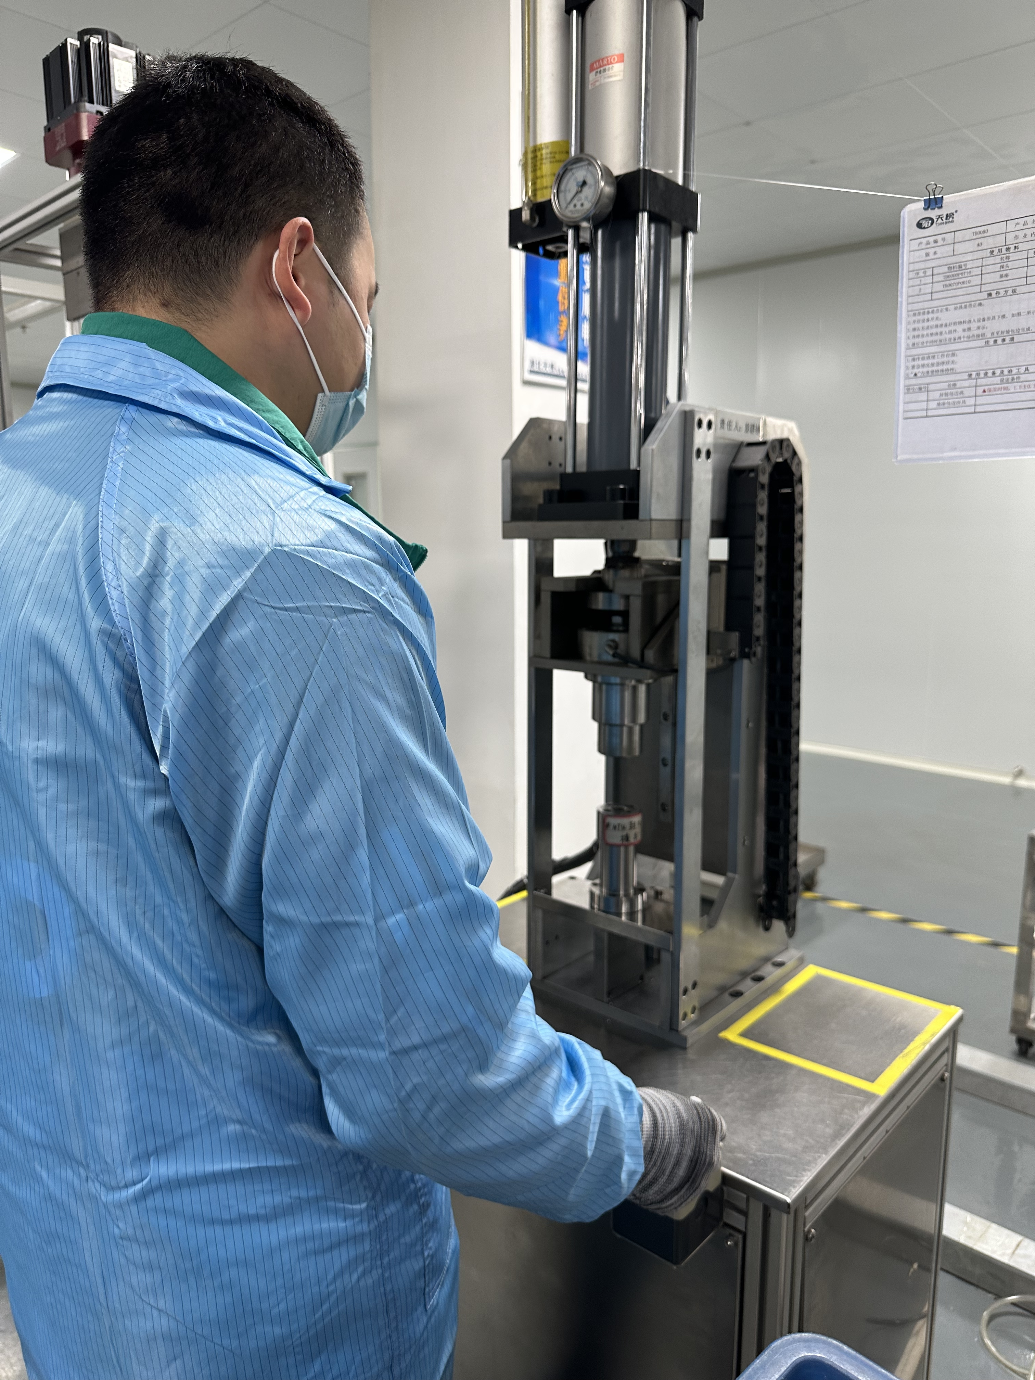
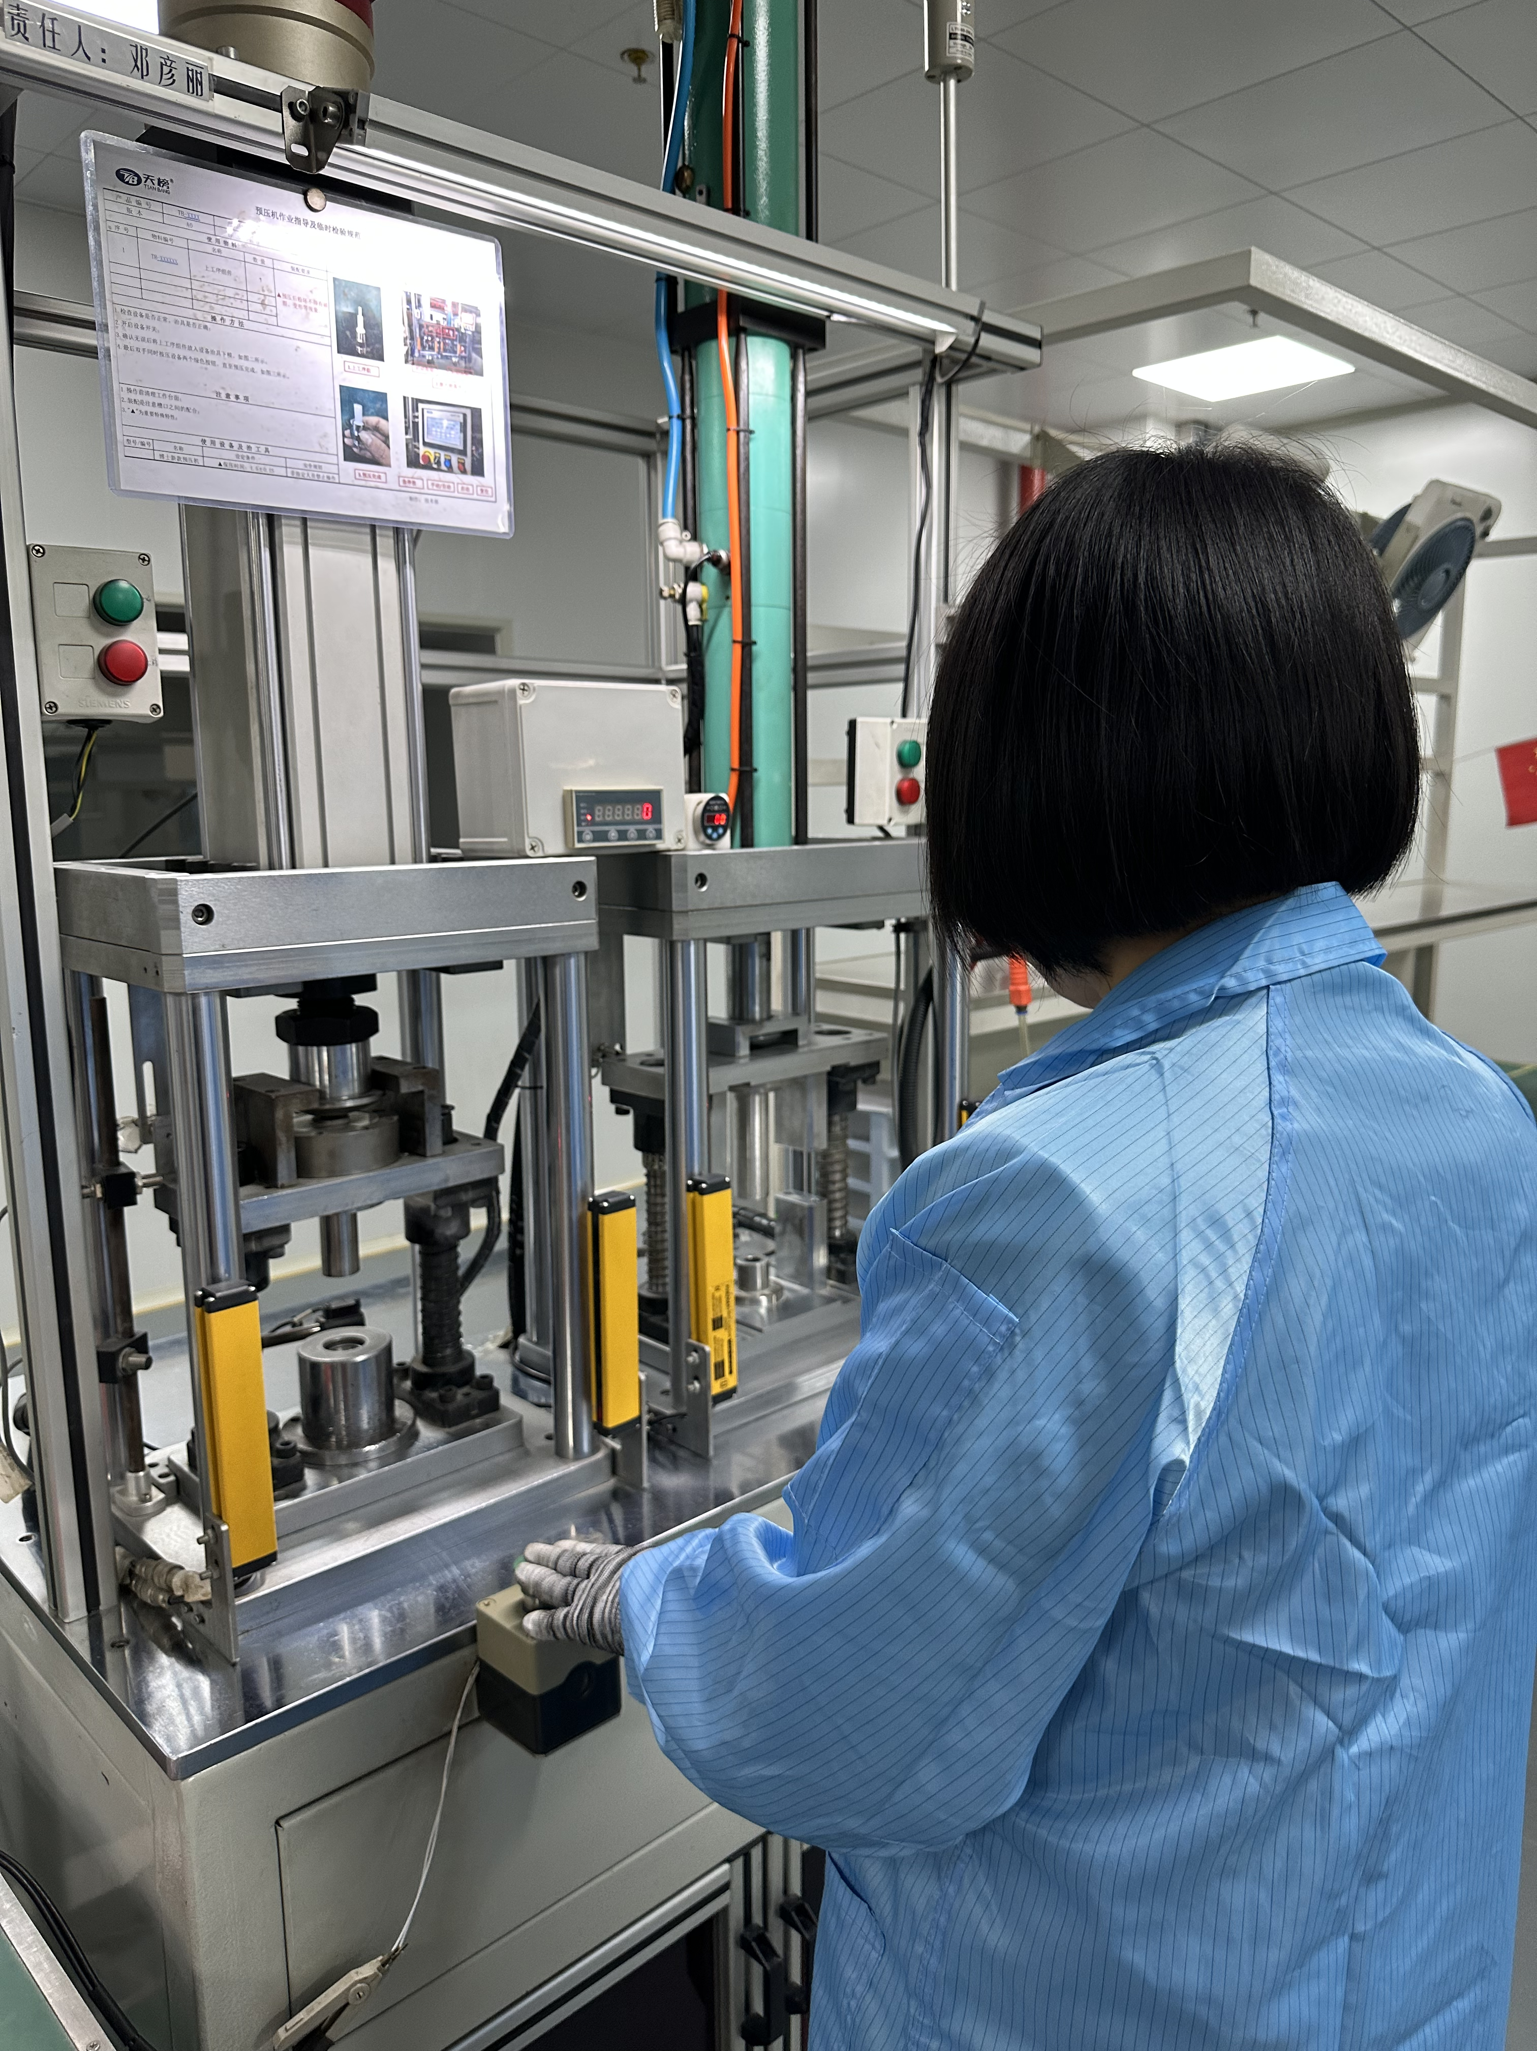
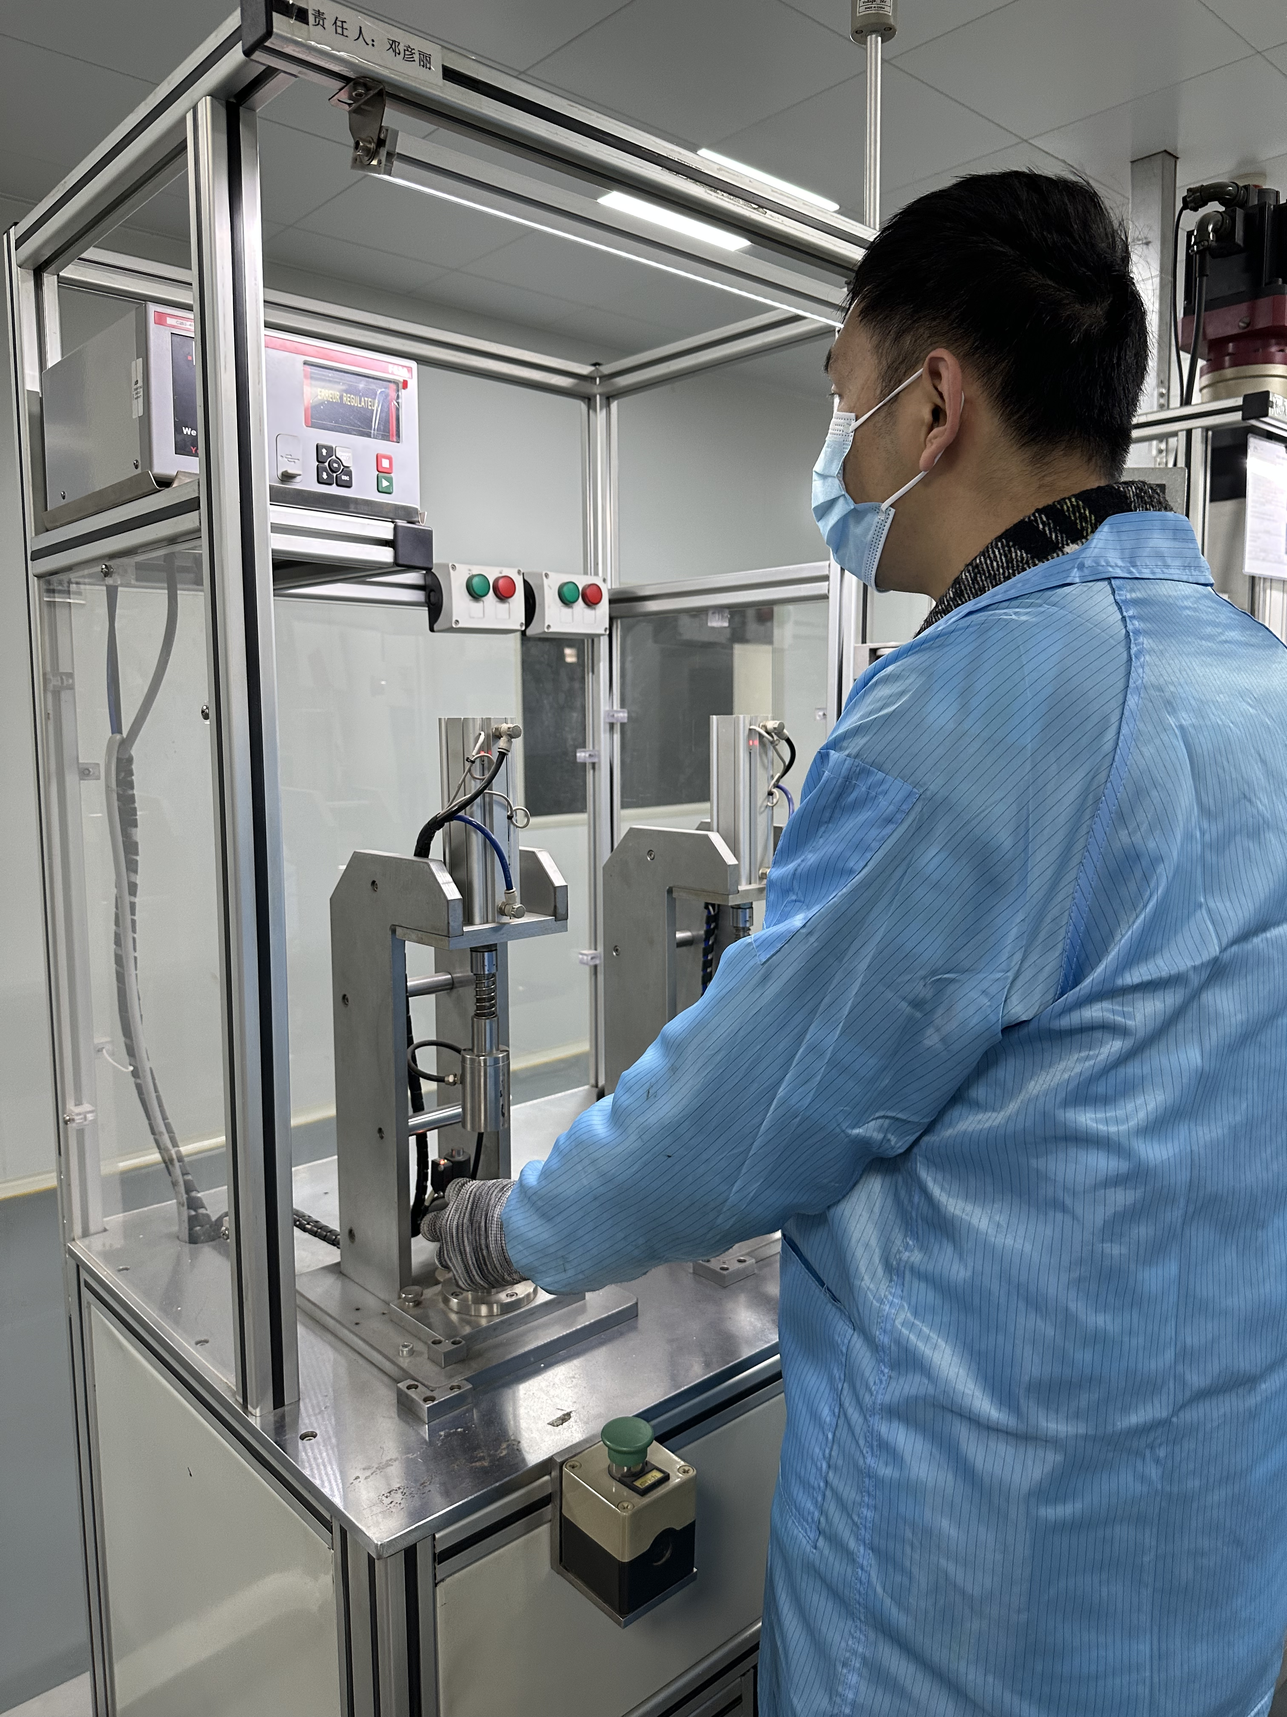
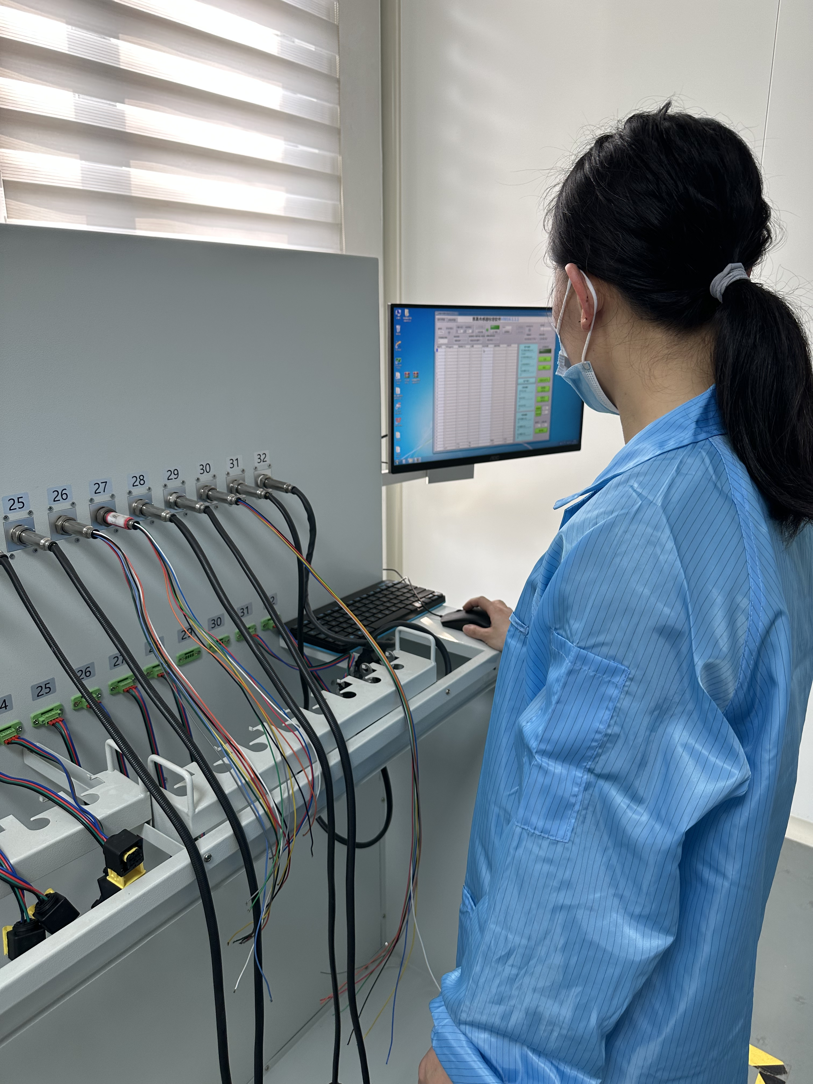
Workshop-Assembly
2000㎡ dustless workshop
1 full-automatic production line
1 semi-automatic production line
Every year, there are 1,500,000 oxygen sensors,
200,000 EGT sensors, and 100,000 NOx sensors
assembled here and exported to the worldwide
Chips producing Workshop

Slide 14
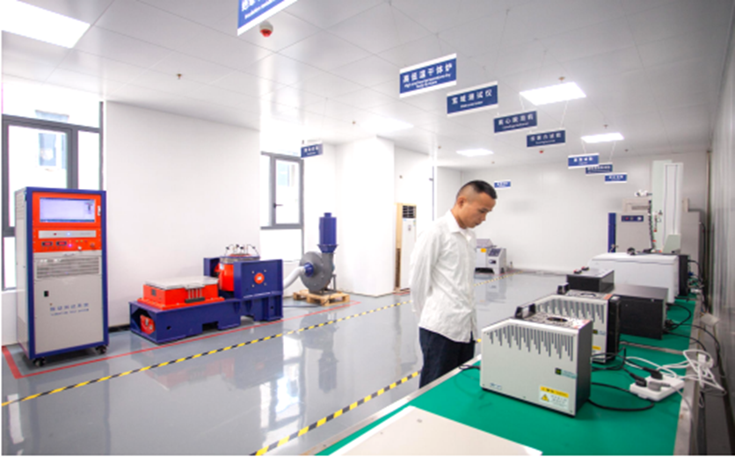
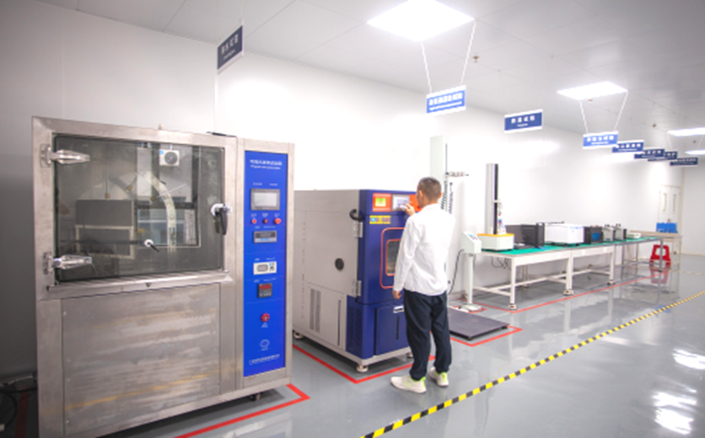
The Laboratory
Self-owned standardization product laboratory to meet industry requirements and are able to satisfy customers’specified needs

Slide 15
Test Items
Burning
test
Impact
test
Leak
test
Swing
test
Salt
spray test
Water
spray test
Crack
detection test
1
2
3
4
5
6
7
14
13
12
11
10
9
8
Sinusoidal
vibration test
Fuel
immersion
test
Insulation resistance test
Chemical Resistance
Low
temperature
test
Stone
impact test
Mechanical
tensile test

Slide 16
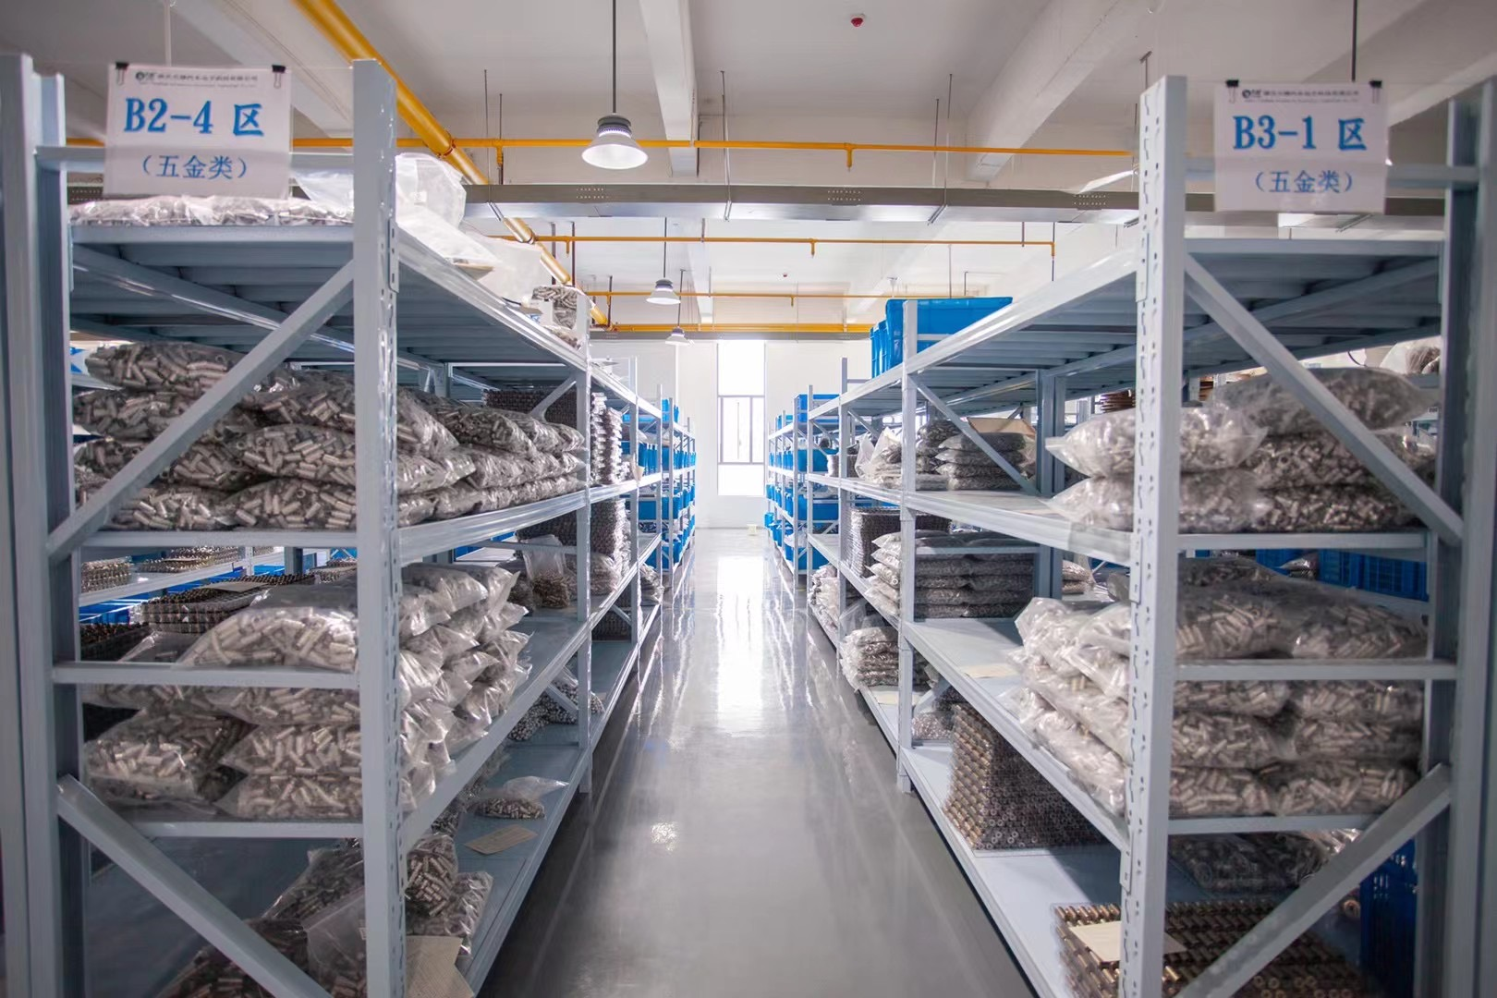
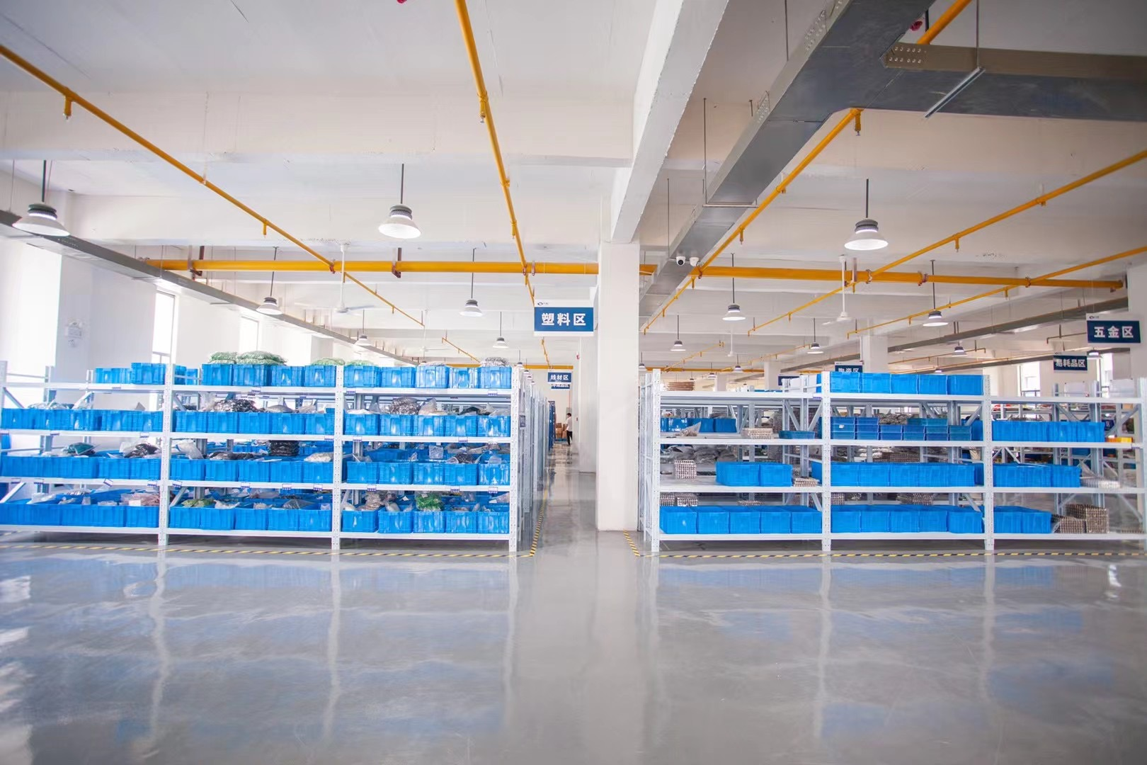
Warehouse
Strictly classify the raw materials according to their types, uses, quality,etc.,
and clearly label their storage locations
Take measures to prevent moisture, sunlight, fire, and electrostatic
discharge to ensure the safety of both raw materials and personnel;

Slide 17
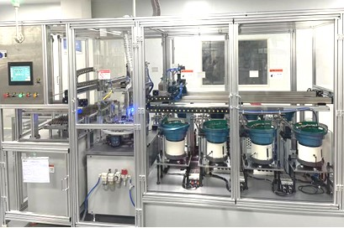
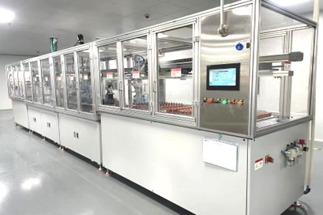
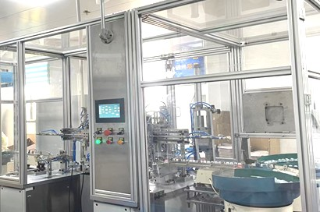
Key Equipments
Automatic Welding
Automatic Assembling
Automatic Packing

Slide 18
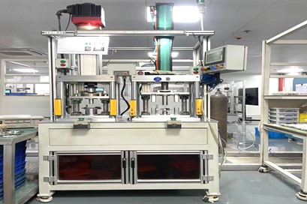
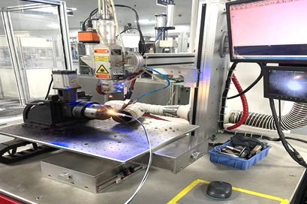
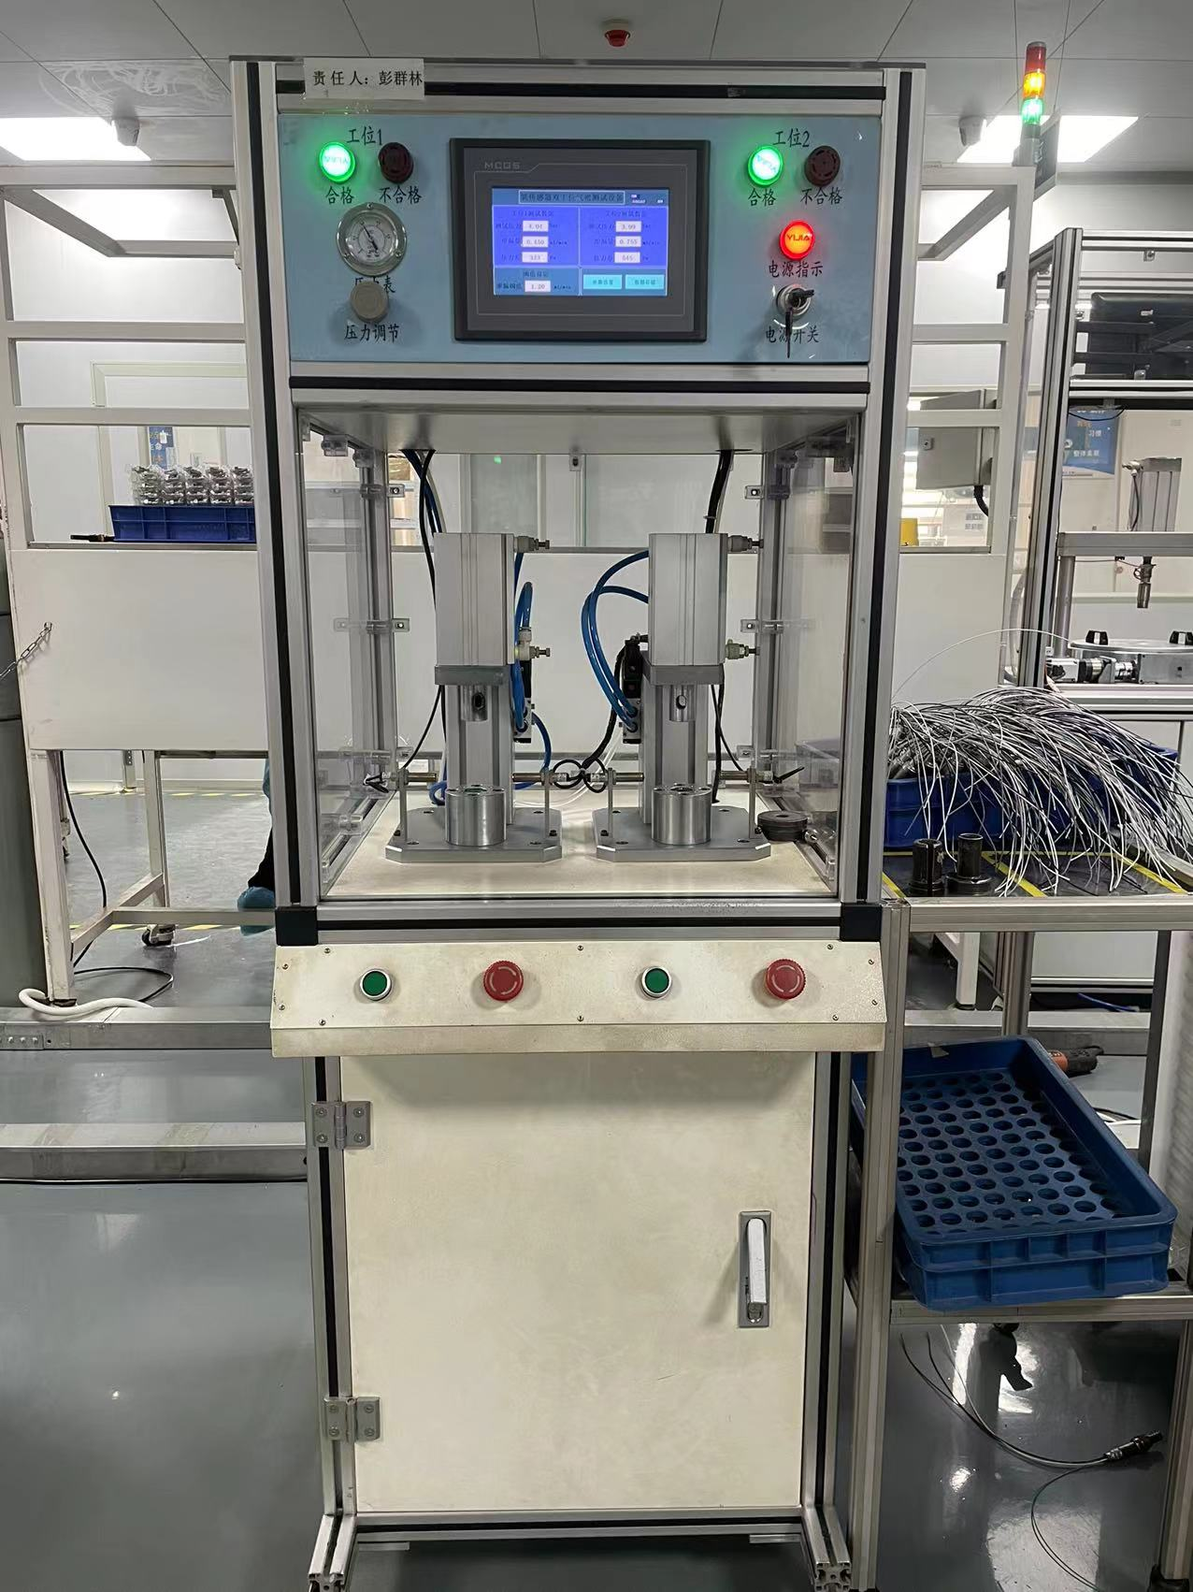
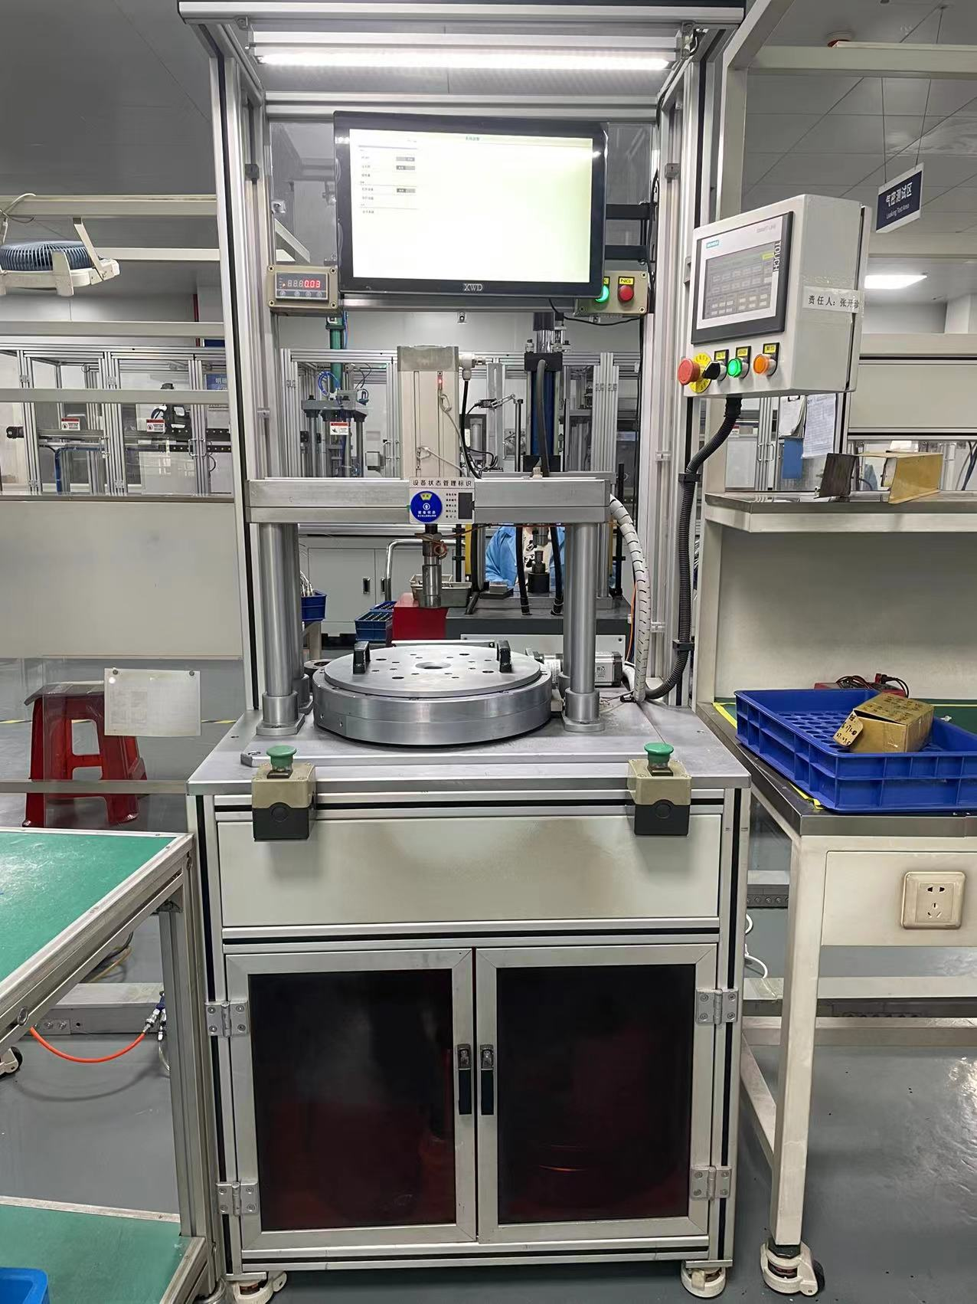
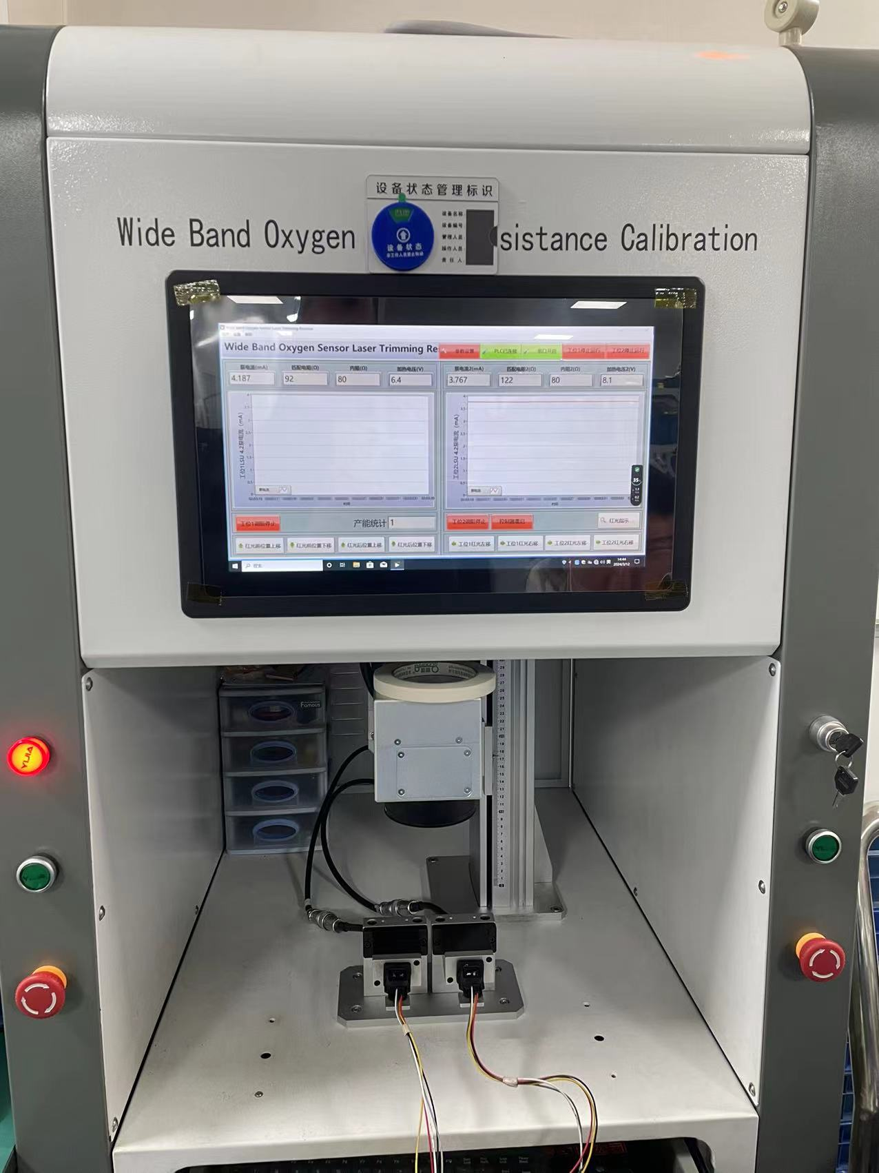
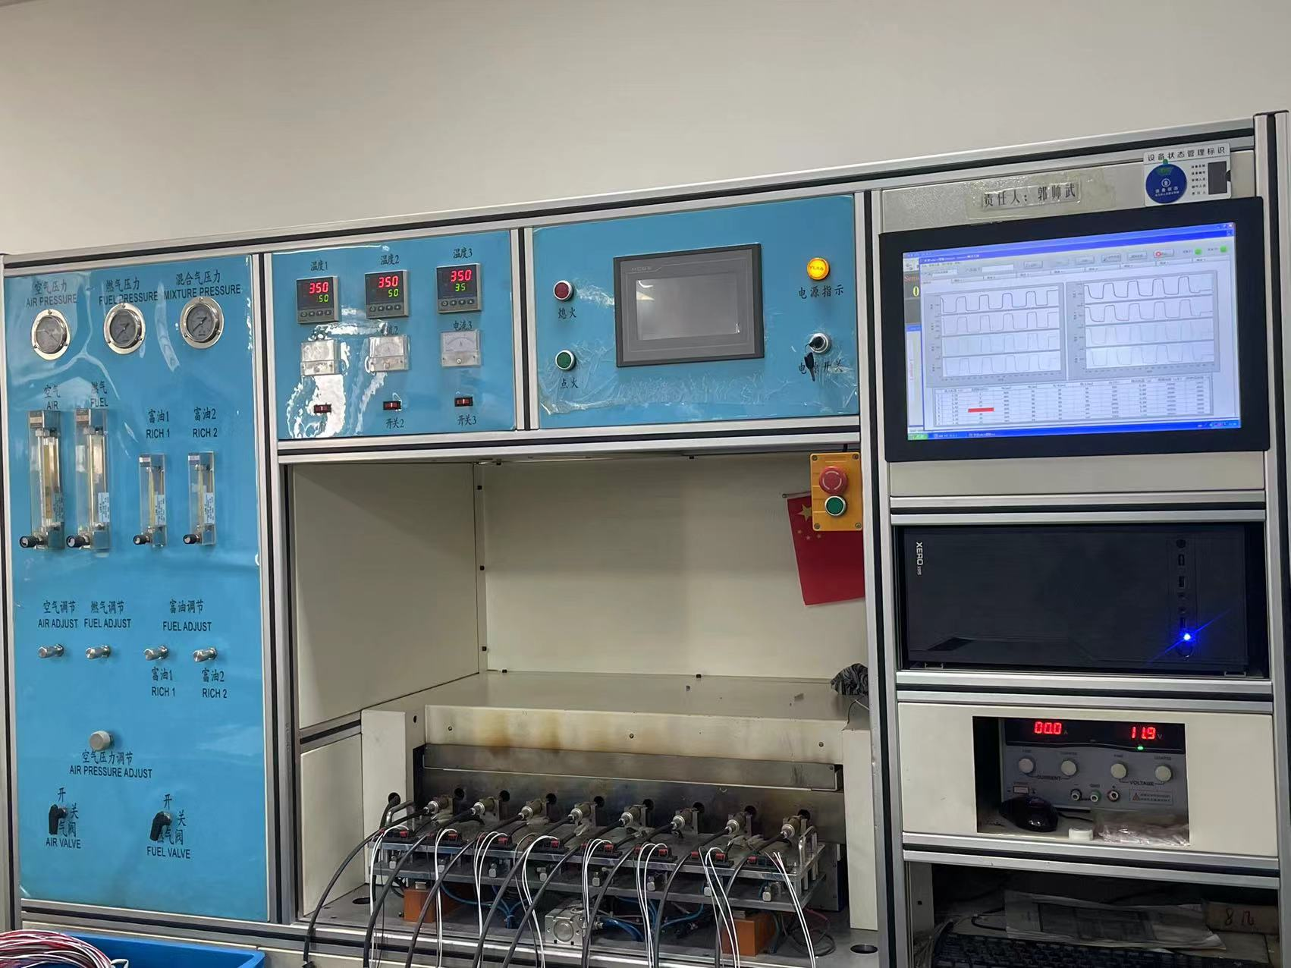
Key Equipments
Semi-automatic Assembly
Imported Laser Welding
单头端子一体机(带压力监测）
Air Tightness Detection
Wideband Sensor
Test Bench
Combustion Test Bench
Crimping

Slide 19
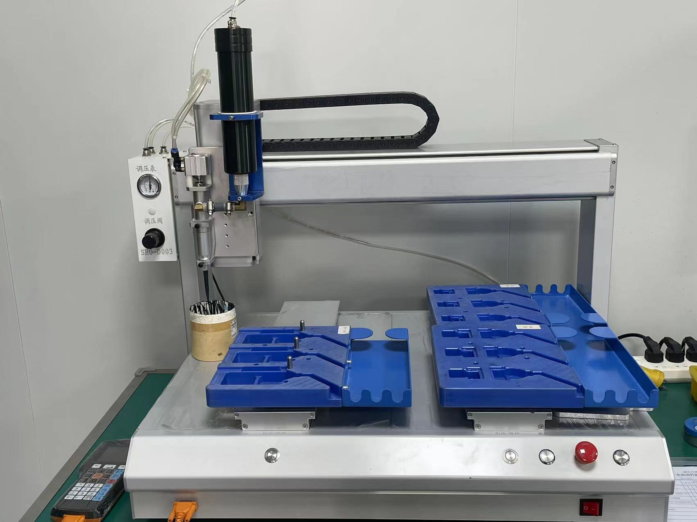
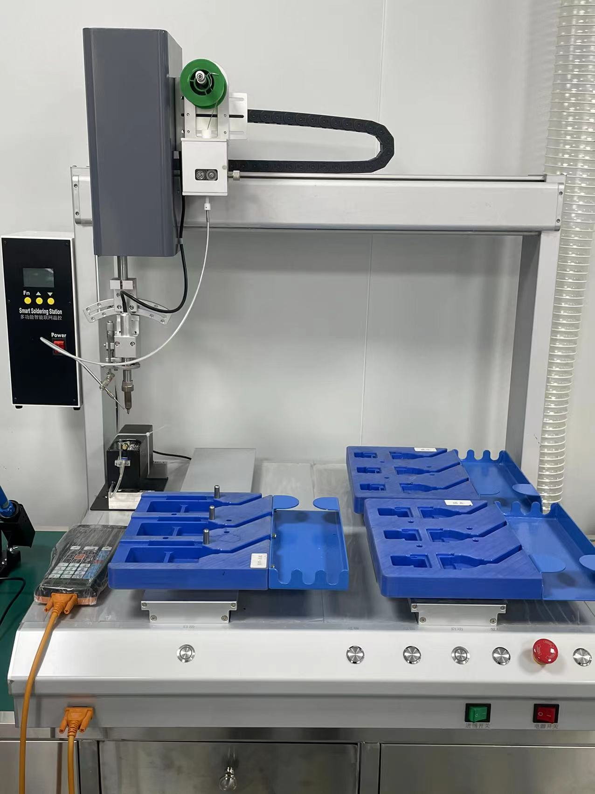
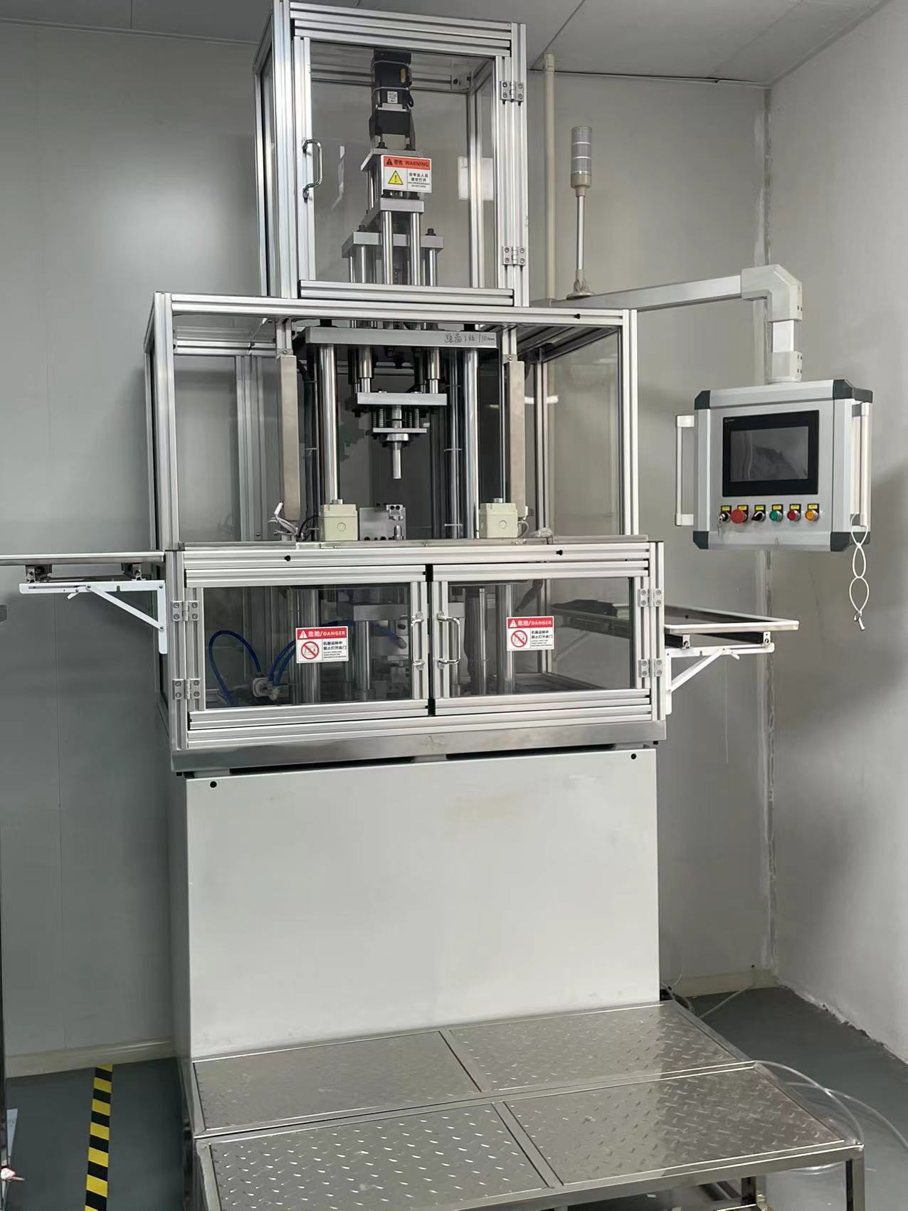
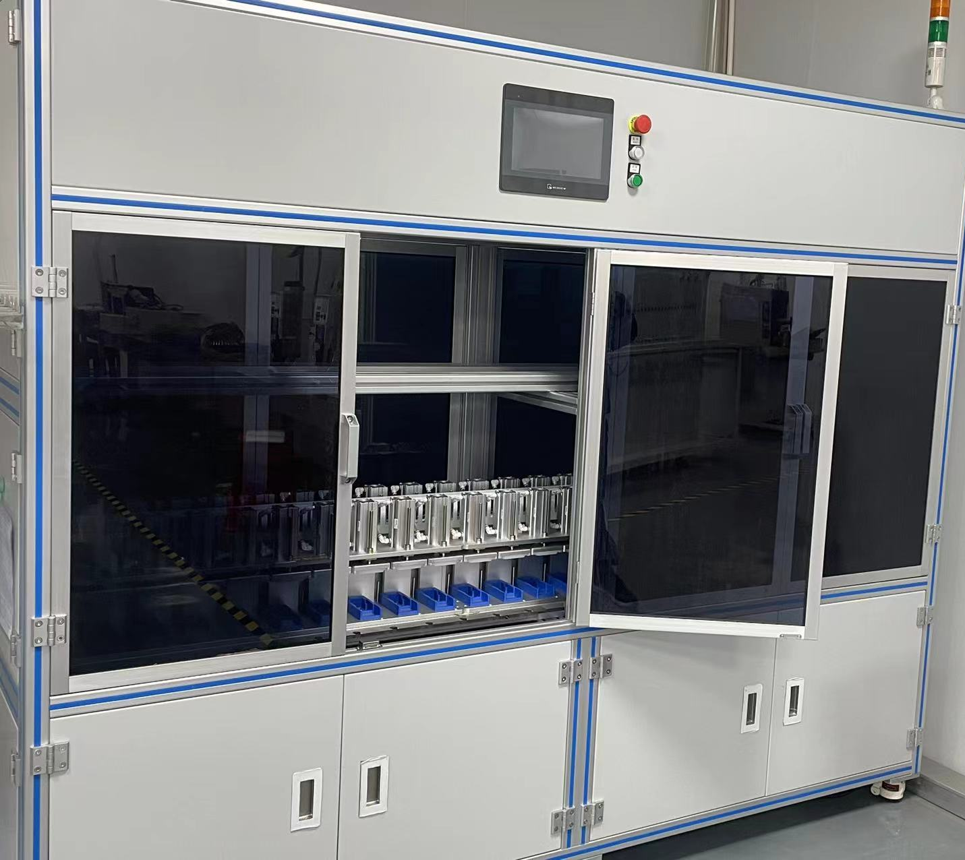
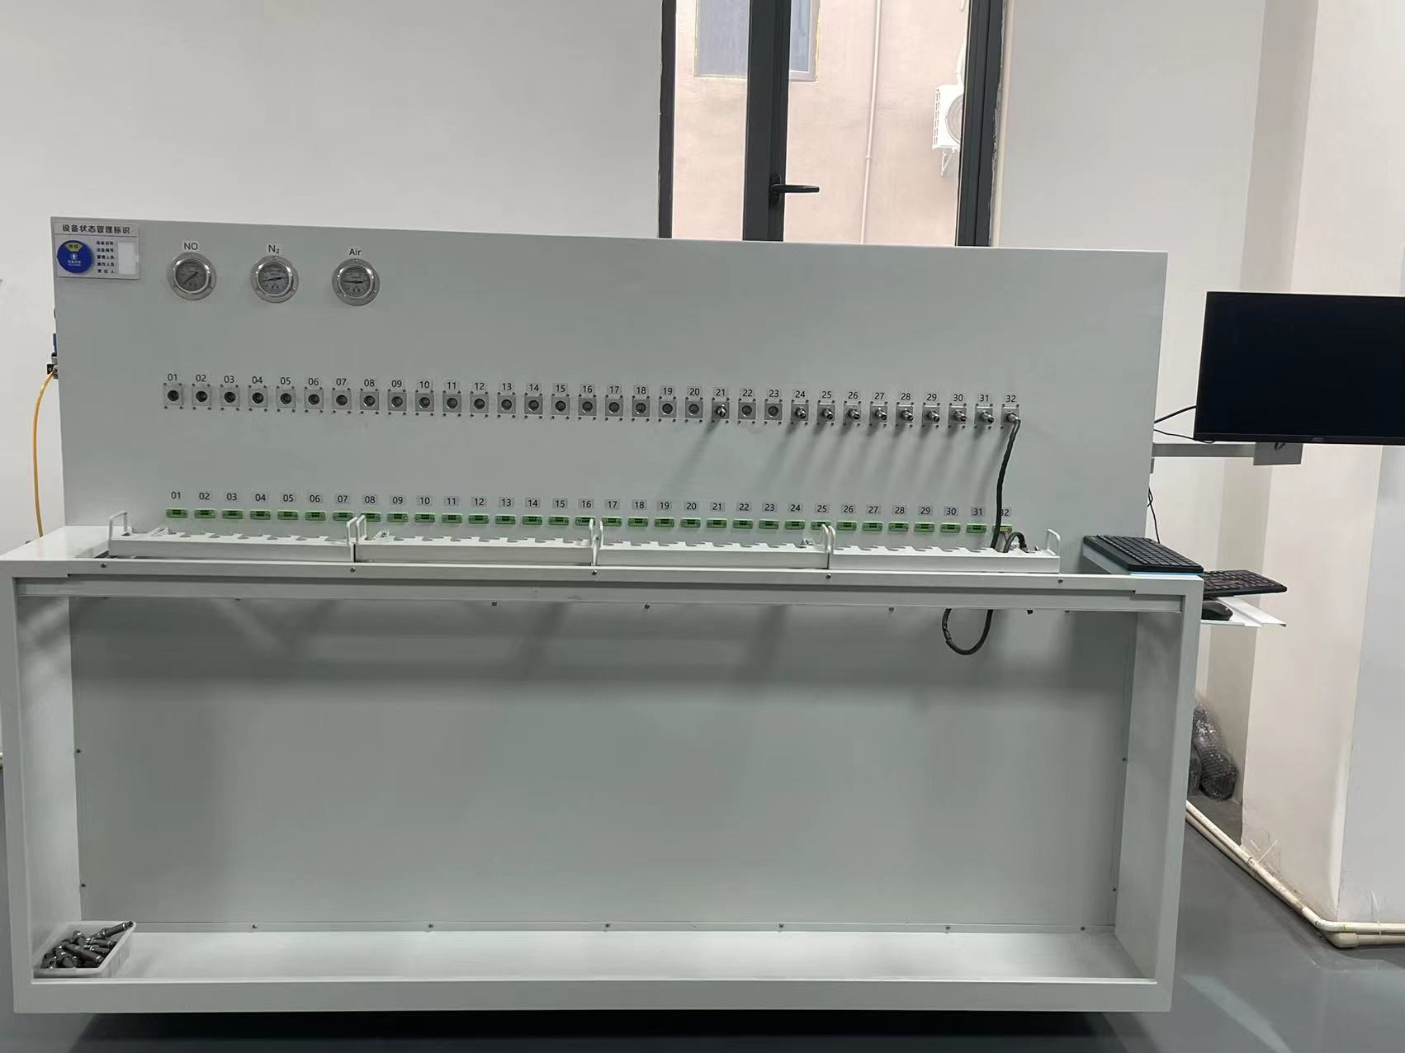
Key Equipments
Automatic Soldering Equipment
Automatic Sealing Robot
NOx Sensor Function Test Equipment
Assembling Equipment
Sealing Equipment

Slide 20
2
Part
Our Products

Slide 21
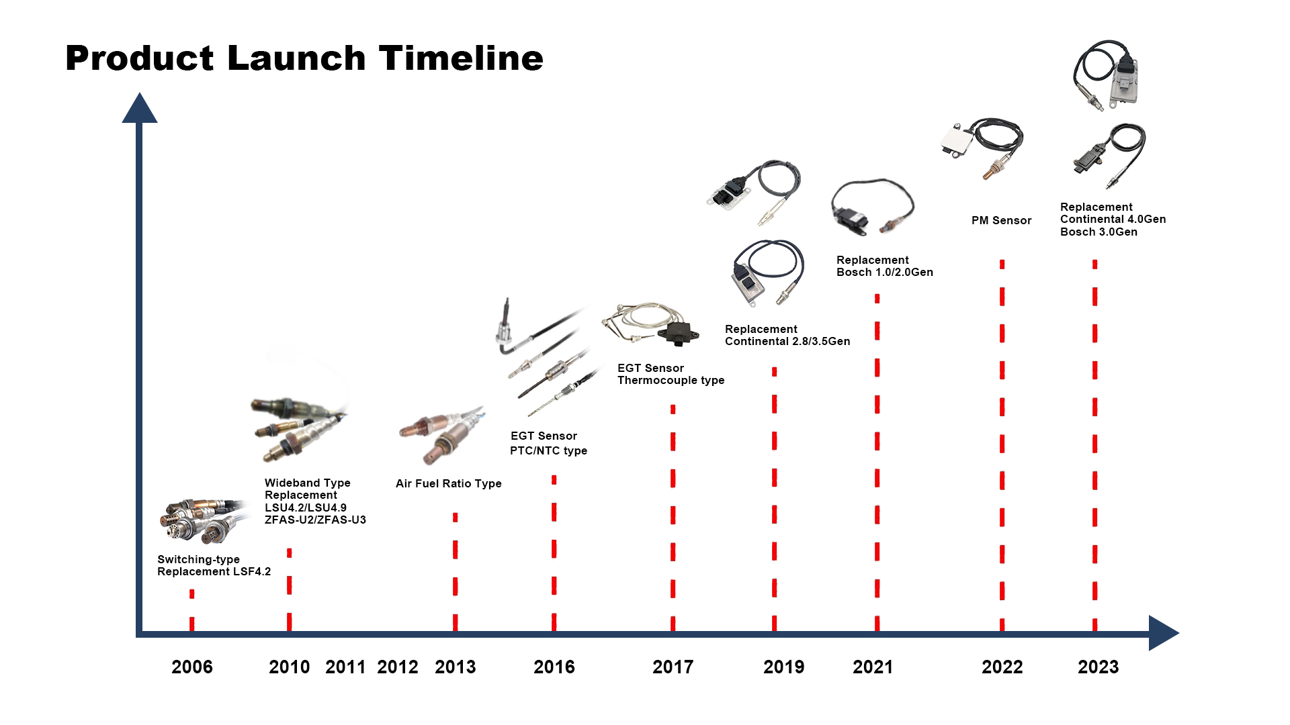

Slide 22
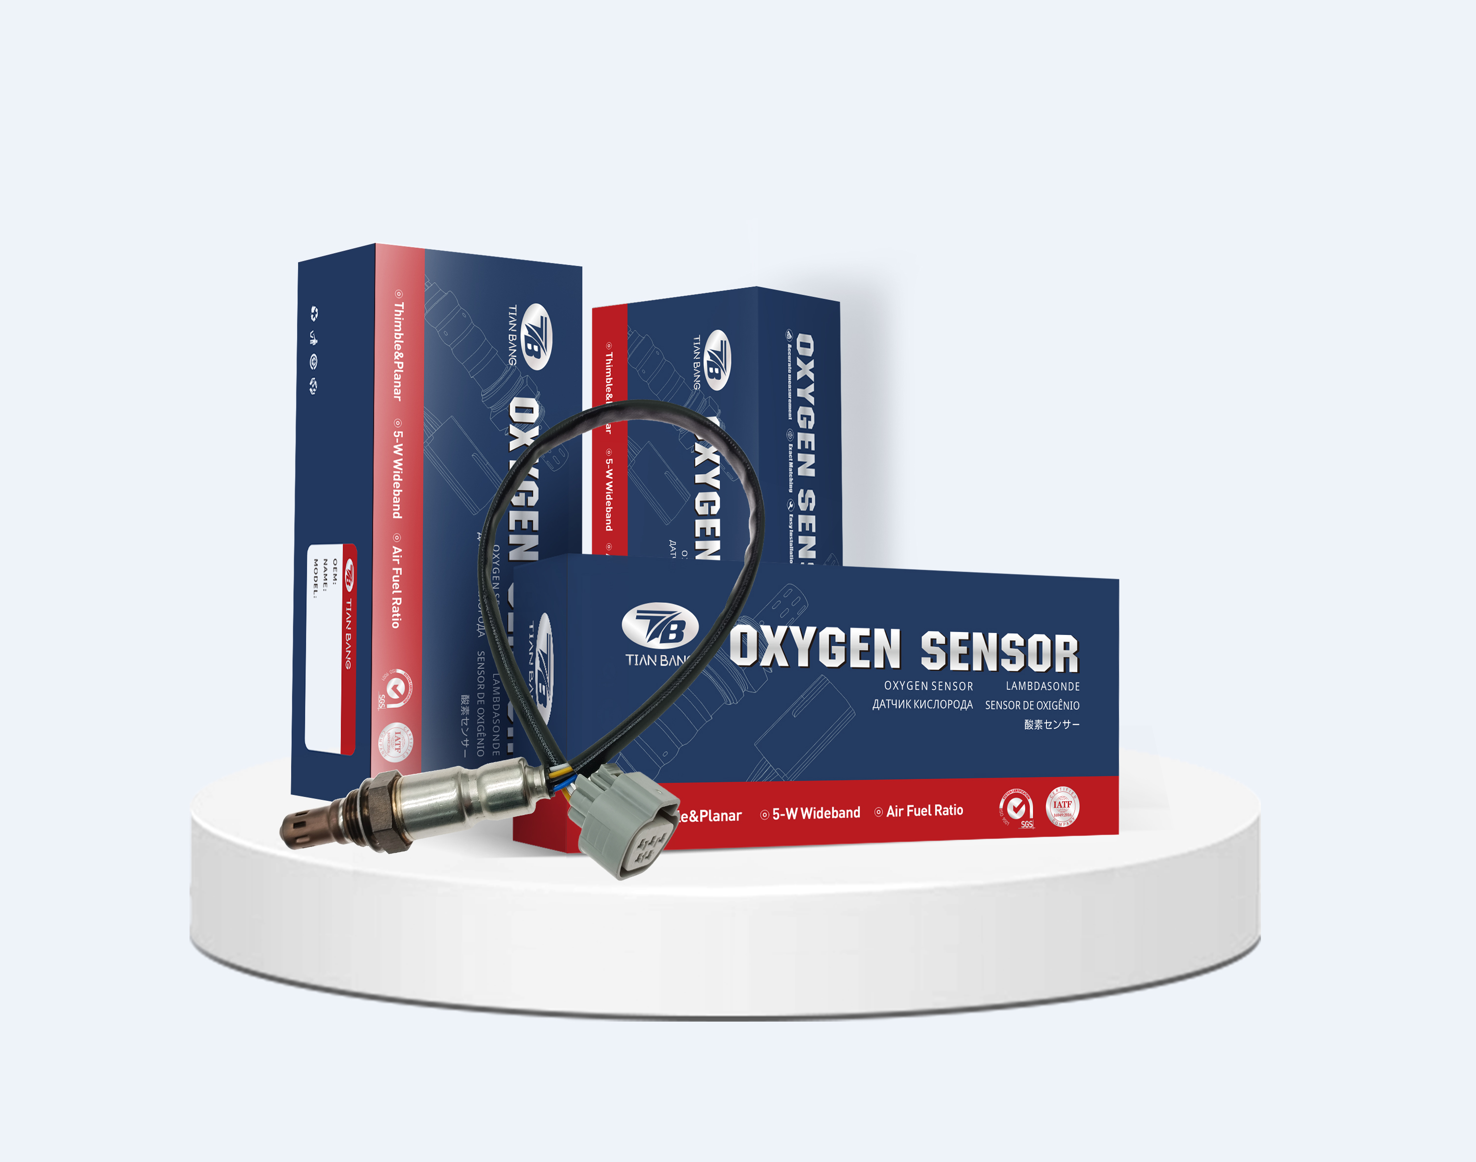
Oxygen Sensors
Capacity:150,000pcs/Month
1 fully automated production line，
2800pcs/Day(8H)
1 semi-automatic thimble-type production line，1800pcs/Day(8H)
1 semi-automatic planar-type production line，2135pcs/Day(8H）

Slide 23
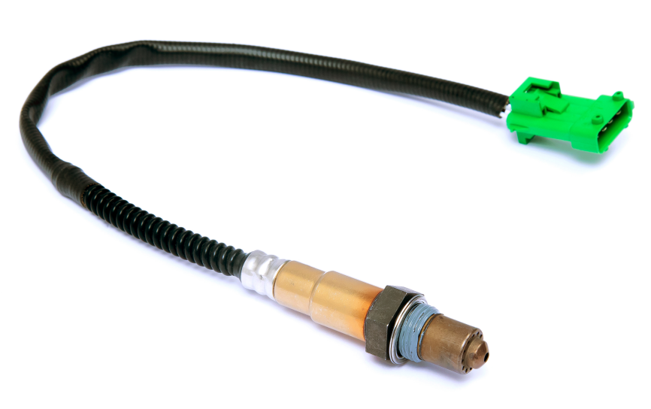
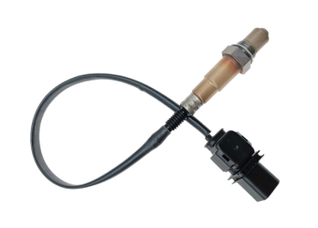
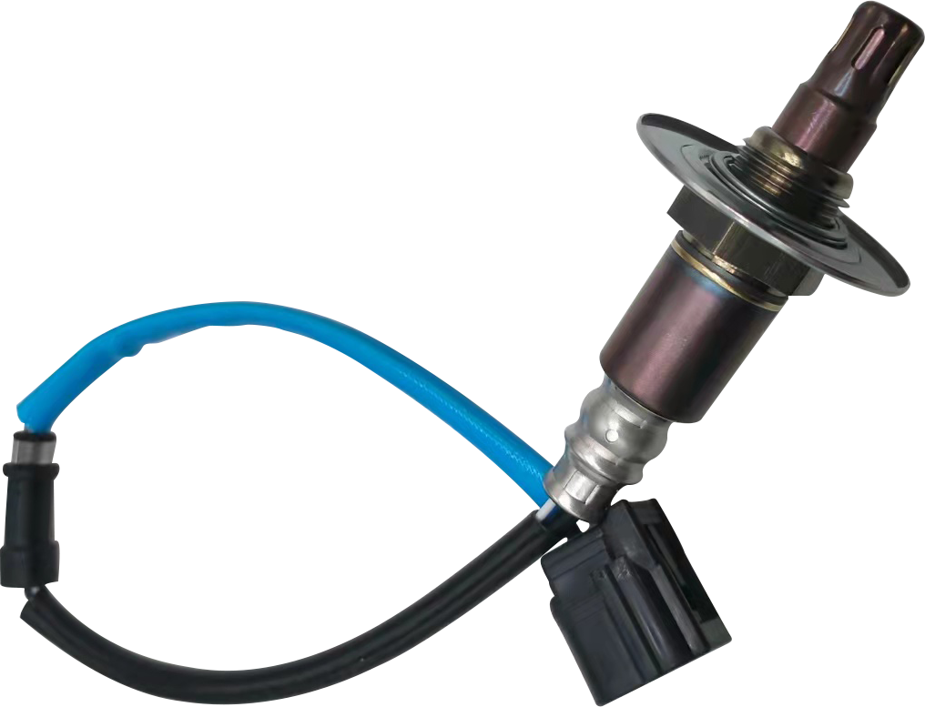
Oxygen Sensors
Switching Type
EXHAUST GAS TEMPERATURE | NEW 350℃ | AFTER AGED 350℃
λ=0.97 Output | ＞745 | ＞680
λ=1.10 Output | ≤100mV | ≤150mV
600mV ~300mV Respons Time | ≤350ms | ≤550ms
300mV ~600mV Respons Time | ≤250ms | ≤350ms
Internal Resistance(KΩ） | ≤5 | ≤15
Heater Current(A) | 0.4-09 | 0.4-0.9
Heater resistance：9 ±1.5Ω
Operating voltage：：12-14V
Max. operating current：0.65A
Operating temperature
(exhaust gas)：≤930℃
Light-off time：≤15S
Wideband Type
Signal Output | Accurancy
λ=0.8 | 0.80±0.01
λ=1.0 | 1.016±0.007
λ=1.7 | 1.7±0.05
Heater resistance：3.2 ±0.5Ω
Operating voltage：：6-8V
Max. operating current：：1.0A
Operating temperature (exhaust gas)：≤930℃
Light-off time：≤：≤10S
A/F Type
Heater resistance：2.7 ±0.5Ω
Operating voltage：6-8V
Max. operating current：1.0A
Operating temperature (exhaust gas)：≤930℃
Light-off time：≤15S

Slide 24

EGT Sensors
Capacity:50,000pcs/Month
1 semi-automatic thimble-type production line，1500pcs/Day(8H)

Slide 25

EGT Sensors
PTC Type
Sensor element::Pt200 platinum resistance
Measurement Principle :The resistance increases with
a positive coefficient as the temperature increases
Resistance：200Ω , 0˚C
Temperature range::﹣﹣40˚C~850˚C Tpeak :950˚C
Accuracy:﹣40˚C~ 280˚C±2.5˚C,280˚C~ 750˚C±0.9%
Response time(T63):T63 <10S @300˚C , gas velocity 11m/s
T63<2.5s @300˚C, gas velocity 80 m/s
Insulation resistance::Rs > 1 mΩ@20˚C,Vdc500V

Slide 26

EGT Sensors
NTC Type
Sensor element:: NTC
Measuring principle: resistance decreases with
increasing temperature
Temperature range: ﹣40˚C~850˚C Tpeak :950˚C
Response time (T63): T63 <10S 25℃-750˚C
Insulation resistance: Rs > 10 mΩ @ 20˚C , Vdc100V

Slide 27

NOx Sensors
Capacity:50000pcs/Month
semi-automatic thimble-type production line
100 Channels NOx Sensor glue sealing equipment
32 Channels NOx Sensor test equipment
2 sets multifunctional chip function test equipment detection
Chips producing Workshop
Sample Showroom

Slide 28


NOx Sensors
NOX measurement range:0-3000PPM
O2 measurement range: 0-21%
Exhaust gas temperature peak: 800℃
Conditions of use: O2(21%) HC COH20(<12%)
Communication interface: CAN
12V Type
24V Type

Slide 29











NOx Sensors
4 pins
5 Pins
6 PinS

Slide 30
Product Advantages
Matieral Resistance（Max.)

Slide 31


Product Advantages
Response Time
Item | Response Time （S） | Fuel-rich Voltage（mV） | Lean-burn Voltage（mV） | Lean-Rich Response Time （ms） | Rich-Lean Response Time （ms）
TB | 10 | 856 | 55 | 70 | 80
Other Suppliers | 14 | 864 | 67 | 90 | 110

Slide 32


Main Production Processes
Continuous Laser Welding
Automatically adjust the height; focal length correction；
Bi-directional cylinder compression when welding to make sure the protective cover is tightly attached with the Hex housing and increase welding strength and product stability

Slide 33



Main Production Processes
Binder removal sintering-high-temperature baking
Two-stage temperature control，one for binder removal，one for sintering
Real-time temperature monitoring with K-type thermocouple，time control；
Inside Rotating impeller fan ensure uniform temperature

Slide 34


Main Production Processes
Leaking test
Inlet pressure :3.9Bar；
Leakage＜0.2mL/min；
Real time calibration of standard leaks
Real time workpiece volume calculation， ensure that the test results are accurate

Slide 35



Main Production Processes
Six/Eight-petaline pattern intrinsic structure
Two-stage process control，improve efficiency while increasing stability.
Real time lock latch+positioning control ，improving the stability
Bilateral Servo Control ，precise positioning；

Slide 36



Main Production Processes
Integrated wire harness cutting
Real-time pressure monitoring，automatic alarm and stop
stripping length could control under :<500 :±0.5mm，500-1000: ±1mm；

Slide 37



Main Production Processes
Performance Test-Simulating vehicle exhaust emissions
Real-time temperature monitor；
Real-time fuel ratio adjustment
.Real-time Data Acquisition
Air intake atmosphere conversion time:250msX8
Optional pump current mode,current=20nA

Slide 38




Quality Control
Incoming Inspection
Production Inspection
Outgoing Inspection
IQC Inspector check the components’ diemnsions , apperance performance
the inspector check the production process and the semi-finished products
Check the performance ,the appearance ,the model information befoe shipment

Slide 39
Quality Control
IQC
Compliance Department
IPQC
Test Laboratory
OQC
QE
Quality Inspection
Quality Assurance
FQC
SQE
QA
DCC

Slide 40
Quality Control
Weld strength Test
Pullout Strength Test
Check the strength after welding, vigorously tap without falling off, only allowing deformation
Check cables’s pulling force of riveting
On/off test after packaging
Performance Test
Check the chips if broken after package
Simulated the product performance after installed on the vehicles
Field Control
Withstand Voltage Test
Full appearance inspection
Check the chips if with microcrack after package
Check the appearance, wiring harness, connector configuration, etc
Airtightness Test
Outgoing Inspection
Check the the leakage value of finished product
检测出货前的性能，外观，型号等

Slide 41
Quality Control
Change test
Conduct tests after every change in materials, processes, components, etc
Quarterly periodic test
Conduct testing on all products every 3 months
Durability test
Verification Test
Continuously conduct engine bench durability tests on finished products
Maintenance test
Performs performance, waterproofing, and loading tests on products after product maintenance and equipment repair
Prototype test
Newly developed products can only be introduced into production after undergoing experimental verification

Slide 42

Quality Control
Field Control
Everyday check and confirm the production site ,process documents ,data output
Defective product analysis
QC
QC engineer analyze defective products, issue relevant reports and archive them
Training&exam
Every week conduct quality awareness, safety awareness, and environmental awareness training for the related position and will have an exam here

Slide 43
3
Part
Research&Innovation

Slide 44

R & D Team
As one of the leader in the automobile sensor industry,
we specially focus on the development and innovation of the technology
College-Enterprise Cooperation
Our company has long-term close cooperation with
Technology Universities in Wuhan to provide a good
foundation for the company's technological development.
Enterprise-Institute cooperation
In addition, we also has technology exchange and
cooperation with Institute and company in domestic and abroad

Slide 45

R&D Investment
Based on our business philosophy：
Forward by technology,Survive by quality，
the 15% of the sales profit is fixedly invested
in the research and development of the new products every year.
15
%

Slide 46

Development Cycle
In response to the market demand for product diversity, we cooperate with suppliers with development capabilities and stable supply capabilities.
In terms of talents, the company has a group of stable development engineers, senior engineers of product,structure and experienced mould designers to ensure the development cycle of products.
45Days
70Days
100Days
New product from
developing partial mould
New Product from
improving some technology
Totally New product

Slide 47
4
Part
Why Choose US

Slide 48

Your Benefits
Product
Complete range of product models, covering 99%
of global vehicle types
Capacity
Sufficient raw materials, skilled operators, multiple assembly lines,ensure the timely delivery
Quality
Years of production experience, lean production and
strictly inspection garrantee premium quality products
Service
Professional and timely pre-sale service, and a
comprehensive after-sale service system

Slide 49

Our Values
Priority
Inquires handling, Favorable price, Samples
providing, Orders proceeding, After-sale service
Fast
According to market trends and changes,
update the list of best-selling and newest products
Flexible
MOQ, Customized packing,priting, Partial shipment
Focused
Focus on customer needs and concerns,
provide the best and most reliable solutions

Slide 50




Our Culture
Principles
Driven by Technology
Survive by Quality
Create value for customers
Bring benefit of staff
Pursue development of company
Contribute to the society
Mission
Vision
To be the most professional and
service-oriented enterprise

Slide 51






Hubei TiIANBANG
Automotive Electronic Technology Co.,Ltd
CONTACT US
No.64 ChuangYe Ave.Tianmen, HuBei,CHINA
sales@tb-autoparts.com
www.tb-autoparts.cn
0086-18972934326

Slide 52

THANKS
Hubei TiIANBANG
Automotive Electronic Technology Co.,Ltd
CONTACT US
No.64 ChuangYe Ave.Tianmen, HuBei,CHINA
sales@tb-autoparts.com
www.tb-autoparts.cn
0086-18972934326

